Slide 1
Michael rosen

Slide 2
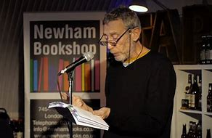
Inside the mind of the poet
Extracts taken from
michaelrosen.co.uk

Slide 3
“When I was a boy, my parents used to play us recordings of poets reading their own poems. My brother and I used to like imitating them. My mother did poetry programmes for BBC SCHOOLS RADIO and I liked them. Nearly all my children have liked poetry when they were young.’’ Rosen…

Slide 4
‘If children get a chance to write poems, it gives them an opportunity to play with language in a way no other activity lets them… it helps them reflect on the world around them and who they are.’

Slide 5
‘Poems are like photos in a photo album, moments, objects, people-frozen for us to look at.’

Slide 6
Rosen’s advice to parents… …read poetry out loud with your children, no matter how short, say them out loud in the car, or over the kitchen table. Let the sound of poetry go in their ears…

Slide 7
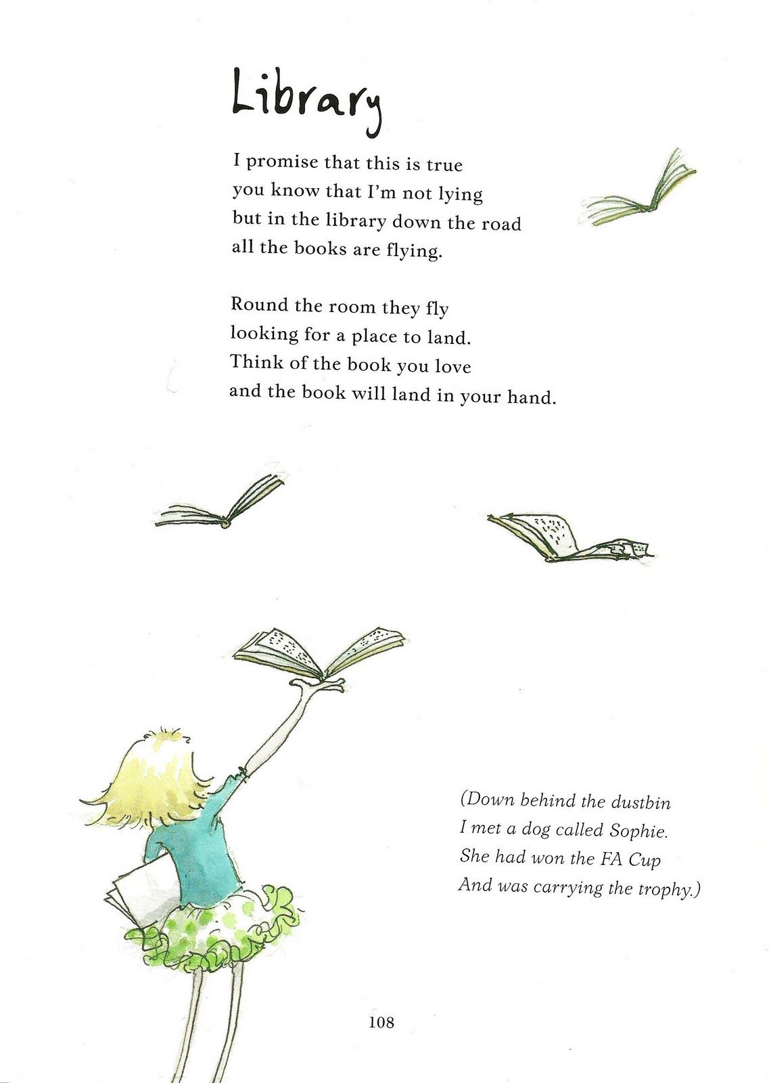
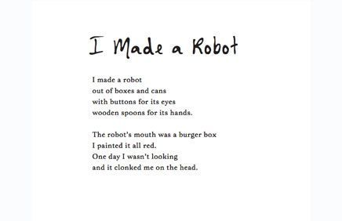
Is rhyme important? “It’s one of the musical instruments in a poet’s box of tricks. Sometimes it’s important, some times it’s funny, sometimes it doesn’t quite work. It all depends.’

Slide 8
Rosen's thoughts on Poetry: Poetry is a special way of talking and writing Poems can be snapshots Poems are places where you don’t have to say at all Poems can pose problems just like life Poems are great for exploring those questions Poetry allows the poet to be whoever and whatever they want to be in a poem Poetry can be impossible, poems often start in the middle of a scene or feeling Poems are full of echoes You don’t have to be right in poetry Poems are great for doubt and wonder Poems don’t take anything for granted Reading and writing poetry shouldn’t be a matter of following a nationally fixed progression, from this or that kind of poem, from 1 year to the next!

Slide 9
Poems I want to share with you… Available on YouTube and Rosen website (adult permission)

Slide 10
1: I’m Tired
This poem makes me laugh as Rosen practically describes my dad and our family.
I'm Tired read by Michael Rosen

Slide 11
2:Hot Food
This poem I am sure, has been written by Rosen at OUR dinner table

Slide 12
3: The Outing
This poem that makes me chuckle as Rosen perfectly imitates the words, threats, instruction and voice intonation

Slide 13
4: We’re Going on a Bear Hunt
As a toddler I had this story book. I adored it. Listening now I recognise that it is more a poem structure, with verse and chorus style, throughout.
I also had a DVD of it, and the amount of times I have listened to it, is countless!
This poem was captivating as a child, some of his poems now captivate me as a teenager as they reflect my own life today with parents, teachers and my brothers!
I do love his dry wit and sense of humour.
Apparently I have the same wit and humour!
Devices
Song
Repetition
Onomatopoeia
Alliteration
Rhythm

Slide 14
Cambridge Independent
Studying this poet, I learned he too contracted Covid 19. However he was nursed back to health by the hands of the NHS.
Irony - he had written a poem to recognise the work it does, for its 60th birthday…

Slide 15
…Rosen falls into the hands of the NHS, not on paper, but in reality this time!

Slide 16
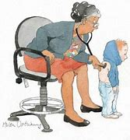
Michael Rosen salutes the NHS on its 60th birthday (2008). He writes it its very own poem!
devices

Slide 17
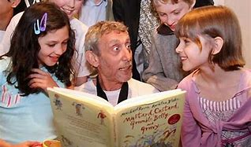
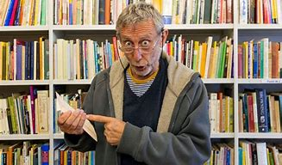
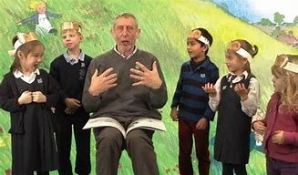
Michael Rosen, the publisher of 140 books to date, will always humour me, at any age. I look forward to sharing his works with my children in the future; especially his recorded readings which capture his facial expressions! Oliver Fulton

Slide 18
Other poems I read this week-
Wordsworth-
Daffodils
Seamus Heaney-
Mid term break,
Digging,
Blackberry Picking,
Scaffolding

Slide 19
By Oliver Fulton

