Slide 1
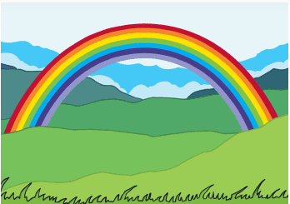
Rainbow Facts

Slide 2
What Is a Rainbow?
A rainbow is a meteorological phenomenon formed when light, generally from the Sun, passes through water droplets hanging in the atmosphere. The atmosphere is a layer of gas that surrounds the Earth which enables us to breathe and protects us from harmful radiation from the Sun.
As the waves of light pass through the water droplets, they change direction, resulting in a multicoloured circular arc.
To be able to see a rainbow, you normally need to have your back to the Sun. Rainbows will usually appear in the section of sky directly opposite the Sun.
Did You Know…? Rainbows are actually full circles.

Slide 3
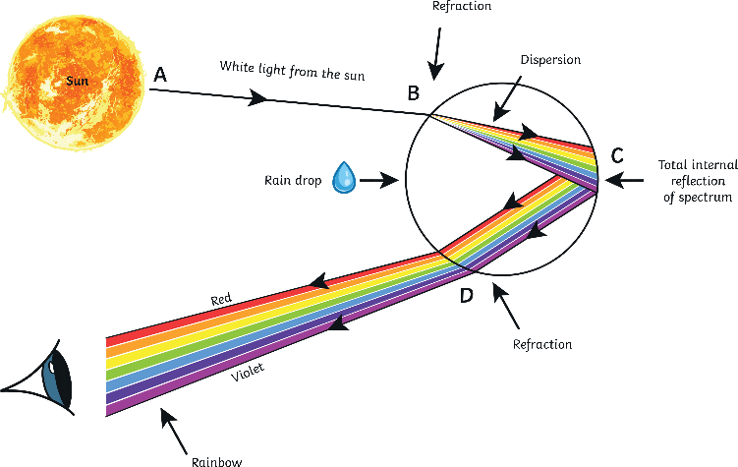
The Physics behind a Rainbow
A rainbow is the result of three scientific phenomena: reflection, refraction and dispersion of light.
White light from the sun enters the droplet of water and is refracted. Refraction causes dispersion in the same way in which white light generates a spectrum of light when it traverses a prism. Inside, at the back of the droplet, this spectrum is reflected and refracted once again when leaving the droplet.
prism
refraction
reflection

Slide 4
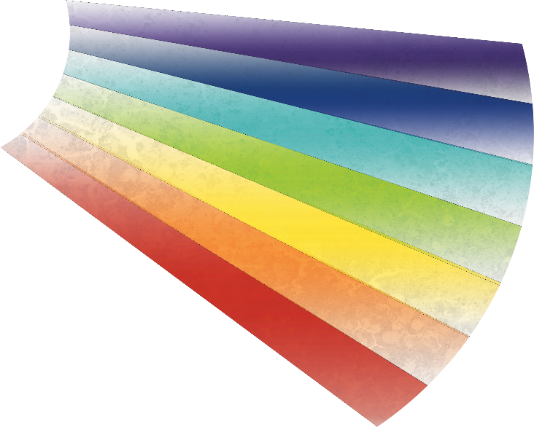
The Colours of the Rainbow
Do you know the colours of the rainbow?
If you don’t, there is a rhyme that can help you remember them:
Richard Of York Gave Battle In Vain.
R for red,
O for orange,
Y for yellow,
G for green,
B for blue,
I for indigo and
V for violet!

Slide 5
What Rainbows Represent
Rainbows have represented good luck and hope for humans throughout history.
In the Bible, the book of Genesis tells the story of Noah and the great flood. At the end of the story, the rainbow represents God’s promise to never destroy life on earth with a global flood again.
Rainbow flags have also been used to represent ideas of freedom and multiculturalism. In the German Peasants' War of the 16th century, it was used as the sign of a new era of hope and social change. In Italy, the rainbow flag was first used in a peace march in 1961 as a symbol of peace. Since 1978, it has been used by gay pride and LGBTQ+ movements to represent diversity.

Slide 6
Gold at the End of a Rainbow
In Irish mythology, it is said that the leprechaun’s hiding place for his pot of gold is at the end of a rainbow.
Because the rainbow is an optical illusion, which does not exist in a specific spot in the sky, the leprechaun’s hiding place is impossible to reach.
If you were a magical creature, where else could you hide your treasure that would be impossible to reach?

Slide 7
Rainbows in Stories
One of the most famous songs about rainbows is in the story of ‘The Wizard of Oz’. The song is called ‘Somewhere over the Rainbow’.
Here you have some of its lyrics but there are words missing. Can you guess the missing words?
Somewhere over the rainbow Way up There’s a land that I’ve heard of Once in a
Somewhere over the rainbow
Skies are And the dreams that you dare to dream Really do come
high
lullaby
blue
true

