Slide 1
2d Shapes
What is a 2d shape?

Slide 2

How do you know it is a
2d Shape?
It has only 2 dimensions height
and width.
You can draw it easily on a piece of paper.
height
width

Slide 3
2d means a shape is
‘2 dimensional’

Slide 4
What shape is this?
How many angles and sides does this shape have?

Slide 5
A circle
It has only 1 curved side.
It has no angles.

Slide 6
What is a polygon?

Slide 7
Polygon
A polygon is a flat shape with 3 or more straight sides.
Can you think of any polygon shape names ?

Slide 8
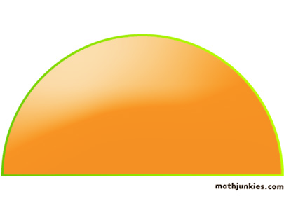
What shape is this?
How many corners and sides does this shape have?

Slide 9
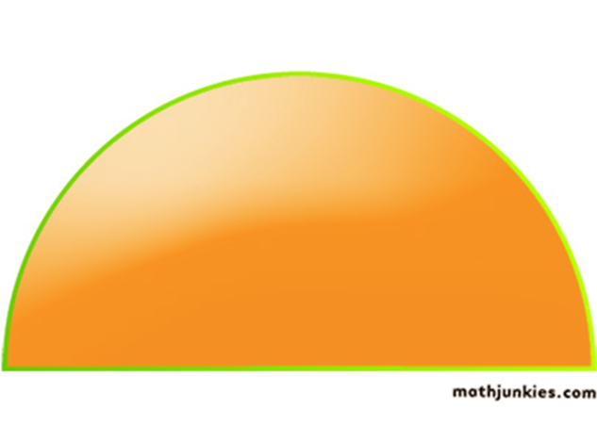
A Semi - circle
It has only 1 curved side and 1 straight side.
It has 2 corners.
A semi-circle is half of a circle.

Slide 10
There are lots of circular
2d shapes in our everyday life
Look around the classroom can you spot any circular shapes?

Slide 11

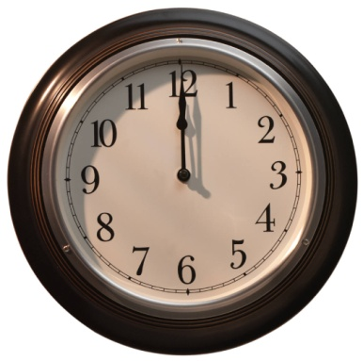
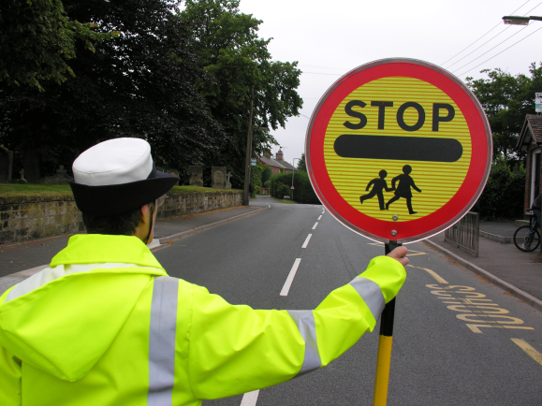
Everyday life
2 sided, triangle shapes.
A cd.
A clock face
The lollipop persons sign

Slide 12
What shape is this?
How many angles and sides does this shape have?

Slide 13
A triangle
3 straight sides.
3 angles.

Slide 14

Everyday life
3 sided, triangle shape.
A road works sign

Slide 15
What shape is this?
How many angles and sides does this shape have?

Slide 16
A Square
4 straight sides, all of equal length.
4 angles.

Slide 17
What shape is this?
How many angles and sides does this have?

Slide 18
Is it a square?

Slide 19
A rectangle or oblong
4 straight sides.
2 sides are longer, have a look.
4 angles.

Slide 20
Everyday life
4 sided, rectangle shapes.
The interactive white board.
Your work book.
Shape of the top of your desk

Slide 21
What shape is this?
How many angles and sides does this have?

Slide 22
A Pentagon
5 angles
5 flat sides.

Slide 23

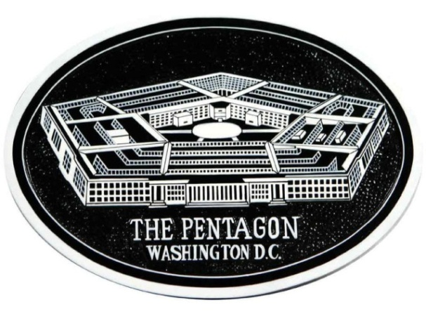
Everyday life
5 sided, Hexagonal shapes.
A football is made up lots of pentagons.
The Pentagon in America is a pentagon.

Slide 24
What shape is this?
How many angles and sides this shape have?

Slide 25
It is a Hexagon
6 straight sides.
6 corners.

Slide 26
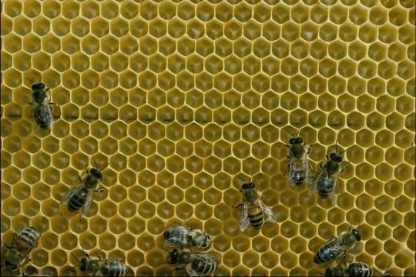
Everyday life
6 sided Hexagonal shapes.
Bee hive cells are hexagonal.

Slide 27
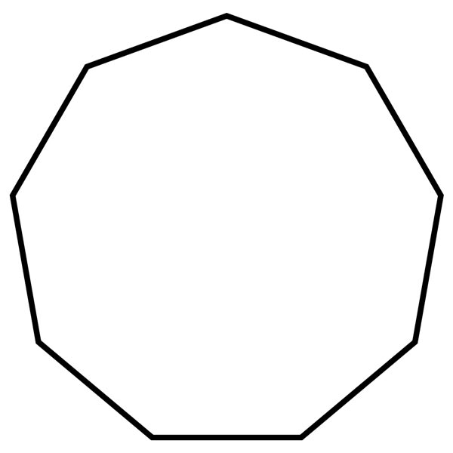
What shape is this?
How many angles and sides does this shape have?

Slide 28
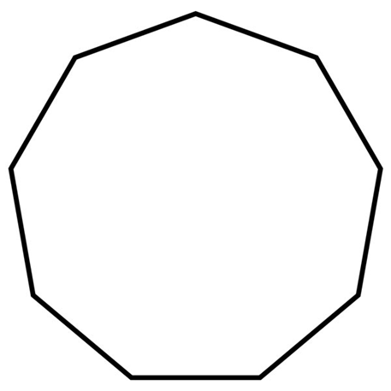
It is a Heptagon
7 sides.
7 corners.

Slide 29
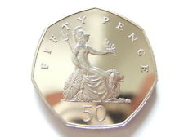
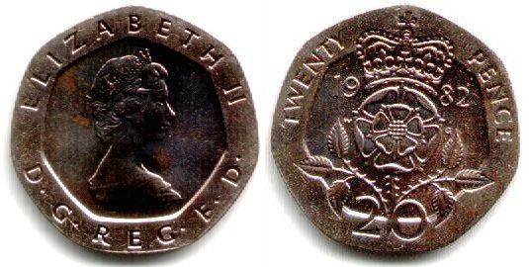
Everyday life
7 sided Heptagonal shapes.
50p and 20p coins we use today are curved heptagonal shapes.

Slide 30

What shape is this?
How many angles and sides does this shape have?

Slide 31
It is a Octagon
8 sides.
8 corners.

Slide 32
Can you think of any words that start with ‘Oct…..’ that will help remind you that an octagon has
8 sides?

Slide 33
Octopus
An Octopus has ‘8’ legs.

Slide 34

Everyday life
6 sided Octagonal shapes.
The ‘STOP’ road sign has 8 sides and is a hexagon shape.

Slide 35
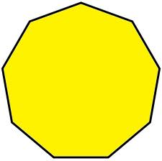
What shape is this?
How many angles and sides does this shape have?

Slide 36
It is a Nonagon
9 sides.
9 corners.

Slide 37

What shape is this?
How many angles and sides does this shape have?

Slide 38

It is a decagon
10 sides.
10 corners.

Slide 39
What is a
Quadrilateral shape?

Slide 40
A quadrilateral shape has 4 sides.

Slide 41


Examples of some quadrilateral shapes.
Quadrilateral shapes

Slide 42
Summary of shapes
Circle 1 side
Semi-circle 2 sides - 1 flat side and 1 curved side
Triangle 3 straight sides
Square 4 equal sides and 4 angles
Rectangle 4 sides two longer and 2 angles
Pentagon 5 sides
Hexagon 6 sides
Heptagon 7 sides
Octagon 8 sides
Nonagon 9 sides
Decagon 10 side

