Slide 2
What Is Migration?
Many mammals, birds, fish, insects and other animals move from one place to another at certain times of year. This movement is called migration.

Slide 3
Why Do Animals Migrate?
Animals migrate to find more food or better weather. It may also be a more suitable environment for breeding and raising
their young.
Migration is one way in which animals survive. Animals have been migrating for thousands of years but not all animals migrate.

Slide 4
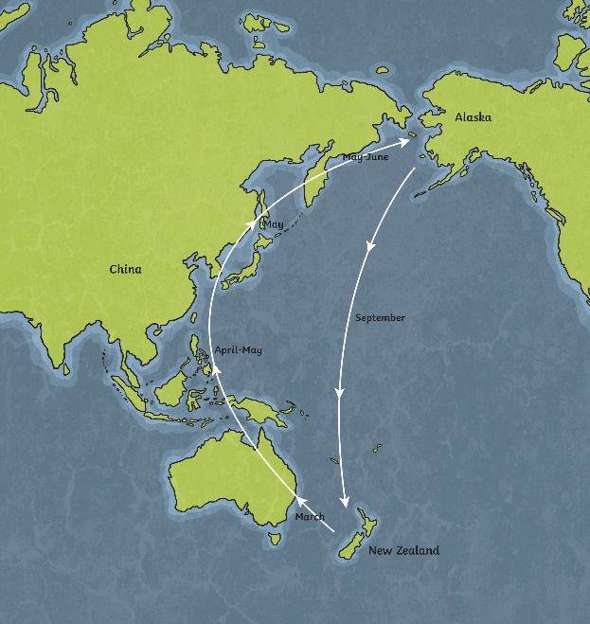
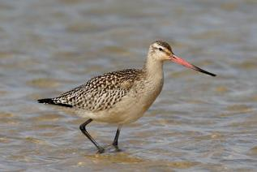
Migration Destinations
Some animals migrate to different parts of a country or to a different country entirely.
Did You Know?
“Bar-tailed Godwit” by Ed Dunens @flickr is licensed under CC BY 2.0
The bar-tailed godwit is believed to travel the longest non-stop journey of any bird in the world. In order to breed, it travels from New Zealand to Alaska - stopping in China on the way. On the return journey, it travels over 7,000 miles without stopping. The return journey takes around nine days.

Slide 5
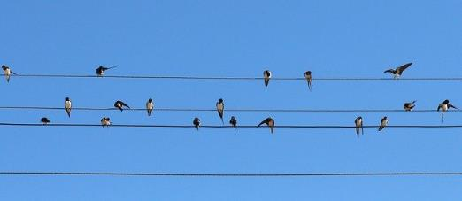
How Do Animals Migrate?
Animals tend to migrate in groups. Why do you think they do that?
Answer
There’s safety in numbers! One of the advantages of flying in a group is that birds have a greater chance of survival against predators. There’s a better chance of spotting a predator within a flock so an individual bird is better protected. Groups of birds can overwhelm a predator and drive it away.
You might have witnessed hundreds of birds sat on telegraph wires waiting to set off together.
It is believed that as well as using the sun and stars to guide their way, they also recognise landmarks which help their sense of direction.
Animals need a huge amount of energy to travel such long distances so they stock up on food before they leave.

Slide 6
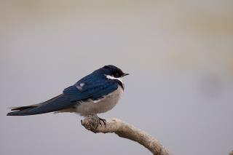
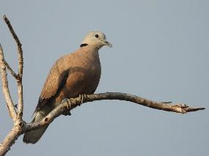
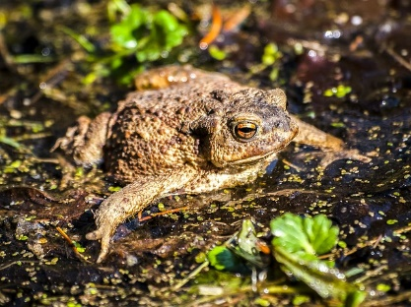
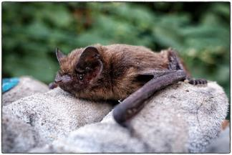
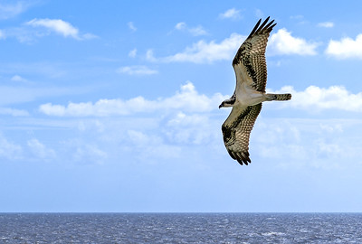
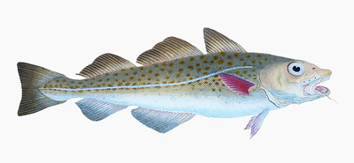
British Migratory Wildlife
Here are some examples of British migratory wildlife.
Click on the images to find out more.
swallows
cuckoos
common toads
pipistrelle bats
osprey
cod
“Common Pipistrelle” by JP @flickr is licensed under CC BY 2.0
“Osprey” by Mike Maguire @flickr is licensed under CC BY 2.0
“The Atlantic cod” by Rawpixel LTD @flickr is licensed under CC BY 2.0

Slide 7
Pipistrelle Bats
In autumn, they tend to migrate from northern parts of the UK to spend winter in the warmer south-west. Some travel as far as southern Europe.
They navigate by echolocation, which means that they make high-pitched noises that bounce off objects. This creates an echo and tells them where they are.
“Common Pipistrelle” by JP @flickr is licensed under CC BY 2.0

Slide 8
Swallows
British swallows migrate from the UK to South Africa in the autumn, covering around 200 miles every day. Swallows can travel up to 35mph. They eat small flying insects, which hibernate when the weather becomes colder, so they have to migrate to find food. They return home in spring because they face less threat from predators in Britain.

Slide 9
Cuckoos
The adults generally leave around the month of June, with their young following them in autumn. They migrate to the warmer forests of central Africa.

Slide 10
Ospreys
These birds migrate to the warmer temperatures of the coast of west Africa. They are large birds of prey that eat fish. They can dive into the water to catch fish, sometimes completely submerging themselves.
“Osprey” by Mike Maguire @flickr is licensed under CC BY 2.0

Slide 11
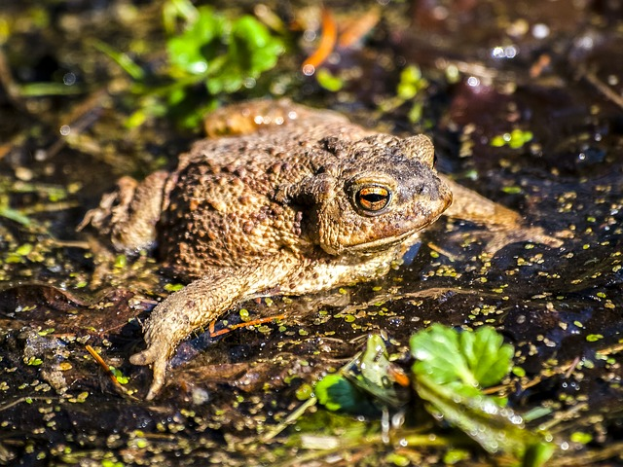
Common Toads
Some creatures migrate shorter distances.
These amphibians live in areas such as woodland, gardens and hedgerows but breed in ponds during the spring and summer.
They generally migrate back to the ponds around mid-February.

Slide 12
Cod
Whilst some creatures migrate to a warmer environment, some do the opposite.
“The Atlantic cod” by Rawpixel LTD @flickr is licensed under CC BY 2.0
Cod are a cold-water fish, found around the British Isles. Some move to colder Nordic and Scandinavian waters during the summer months.

Slide 13
How Might Global Warming Affect These Creatures?
If temperatures increase, ponds may become smaller or dry up.
Where would the toads go to breed?
If the sea temperature rises, cod may have to swim further/deeper to find colder waters.
Could this affect their diet?
“The Atlantic cod” by Rawpixel LTD @flickr is licensed under CC BY 2.0
If UK temperatures rise, will some British migratory birds still need to migrate to warmer countries?
Would these countries become too warm for our birds?
Will we begin to see new birds and insects settling in the UK? Is this already happening?
Will this cause problems for native species?
“Osprey” by Mike Maguire @flickr is licensed under CC BY 2.0

