Slide 2
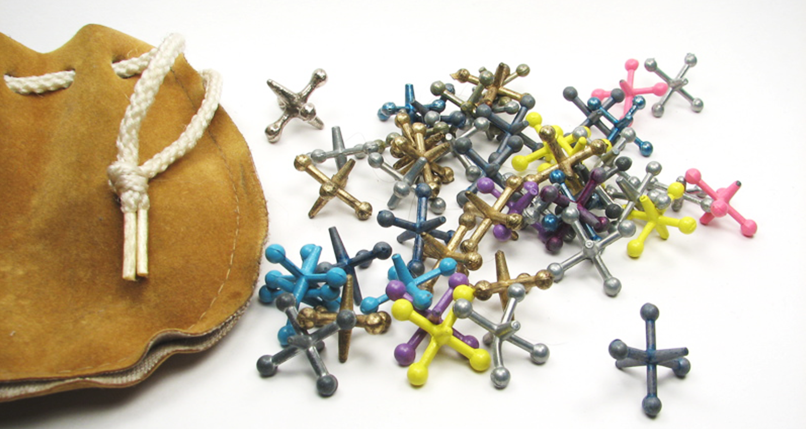
Jacks
Photo courtesy of L. Marie (@flickr.com) - granted under creative commons licence – attribution

Slide 3
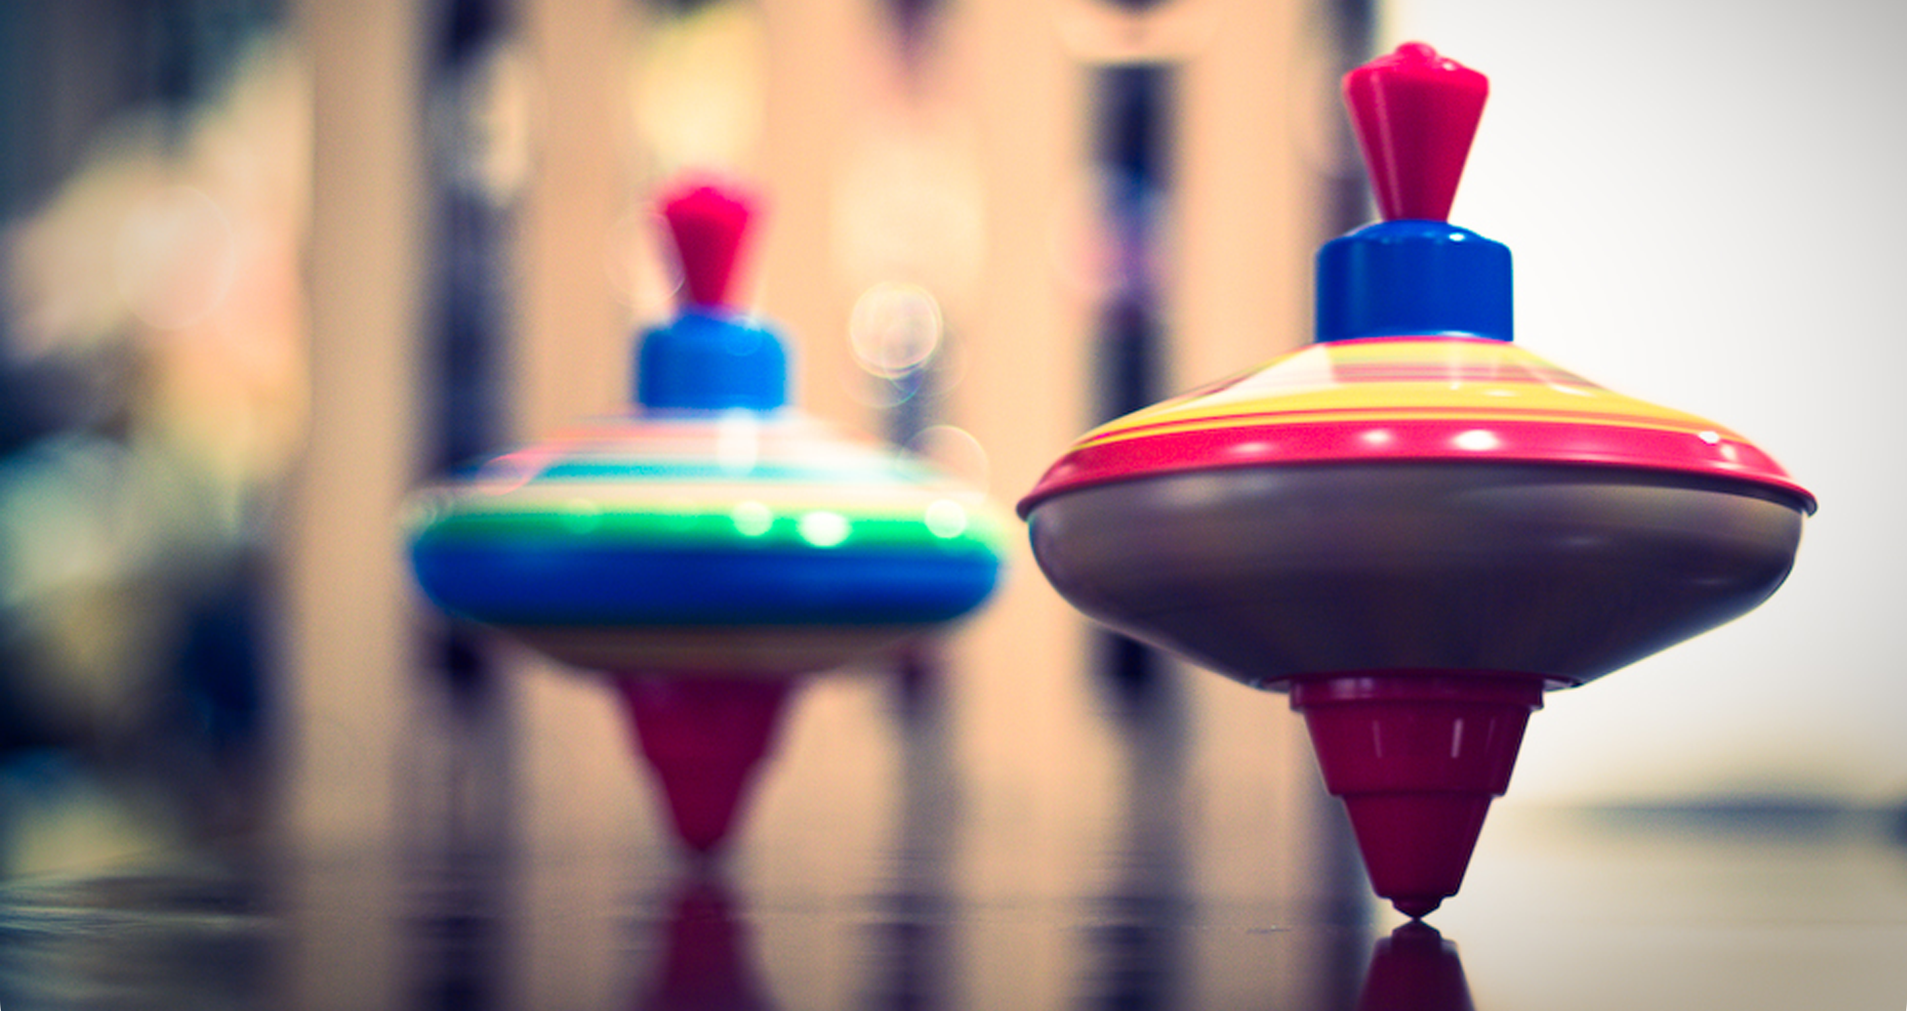
Spinning Top
Photo courtesy of thephotographymuse(@flickr.com) - granted under creative commons licence – attribution

Slide 4
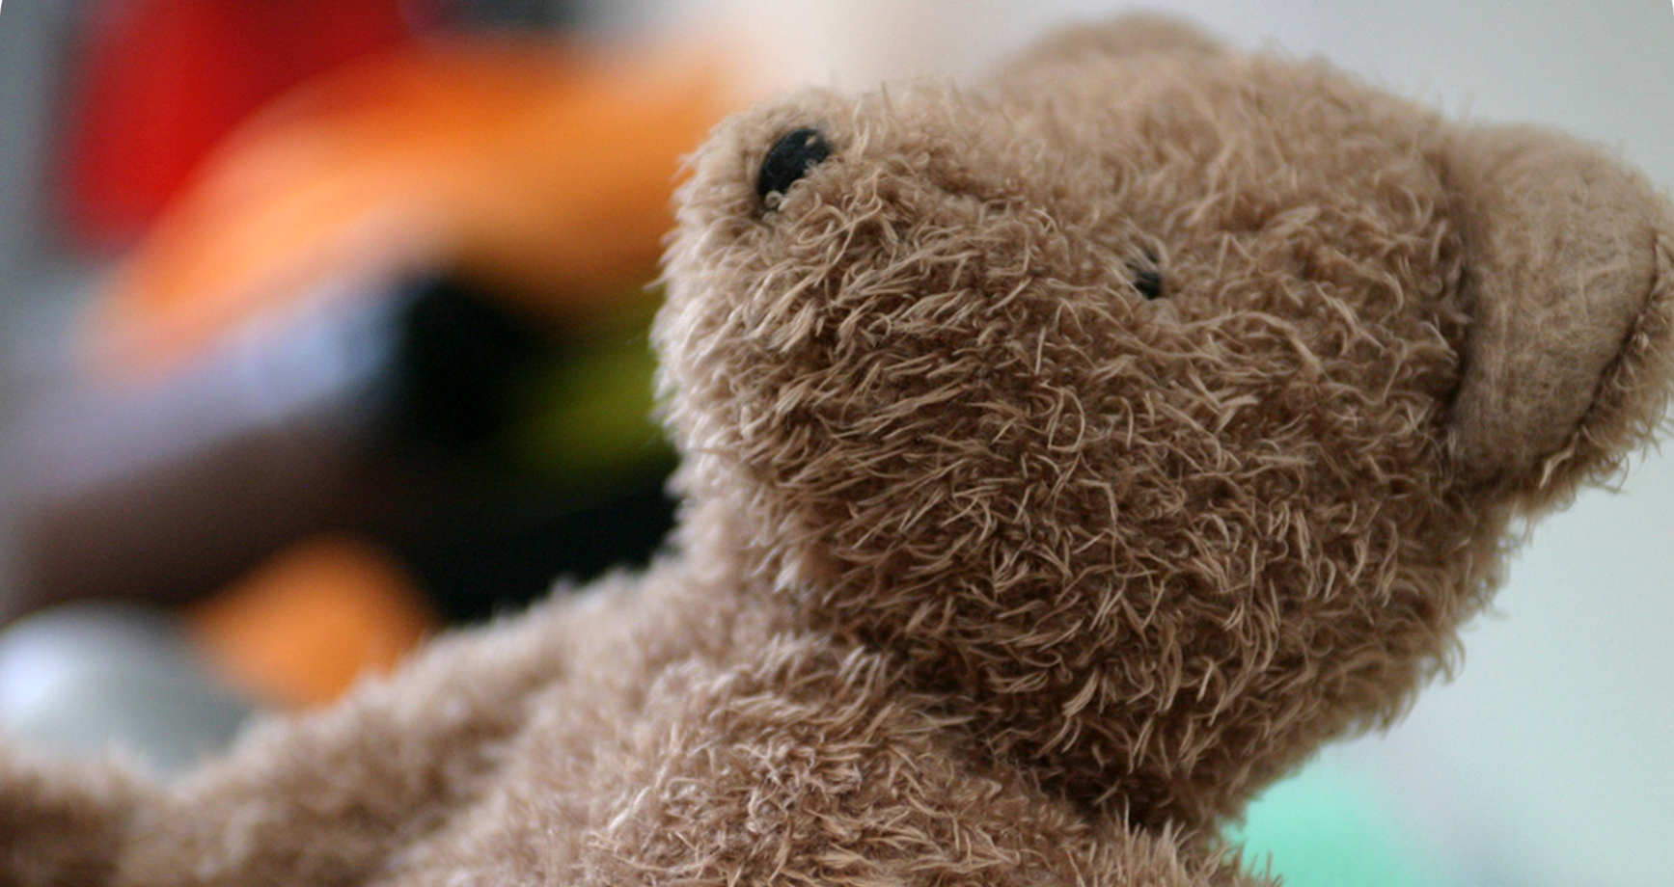
Teddy Bear
Photo courtesy of Stark ting (@flickr.com) - granted under creative commons licence – attribution

Slide 5
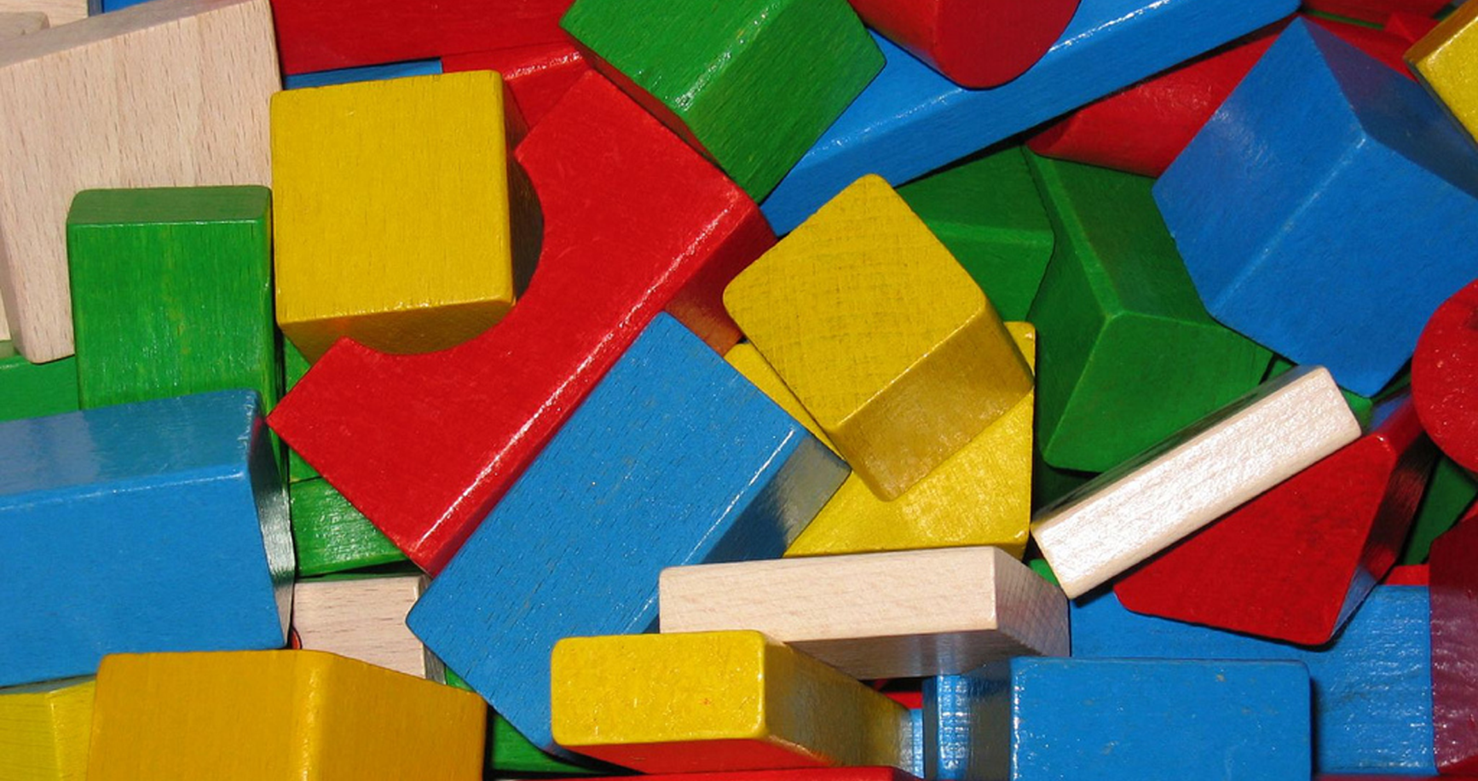
Building Blocks
Photo courtesy of Holger Zschevge (@flickr.com) - granted under creative commons licence – attribution

Slide 6
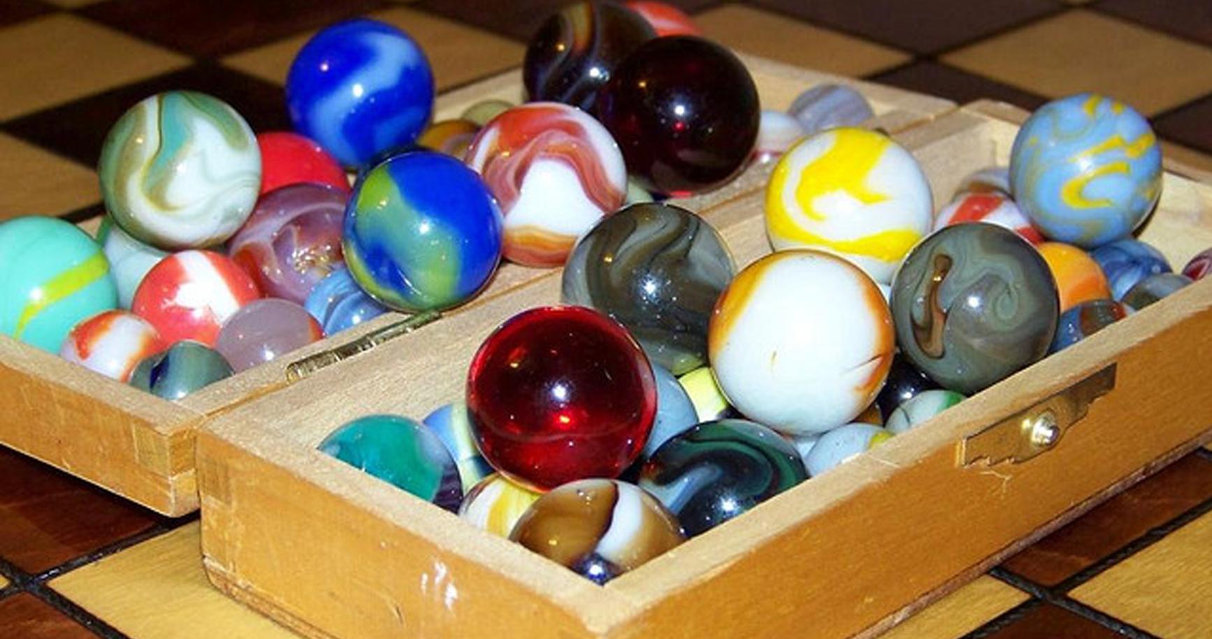
Marbles
Photo courtesy of alexkerhead (@flickr.com) - granted under creative commons licence – attribution

Slide 7
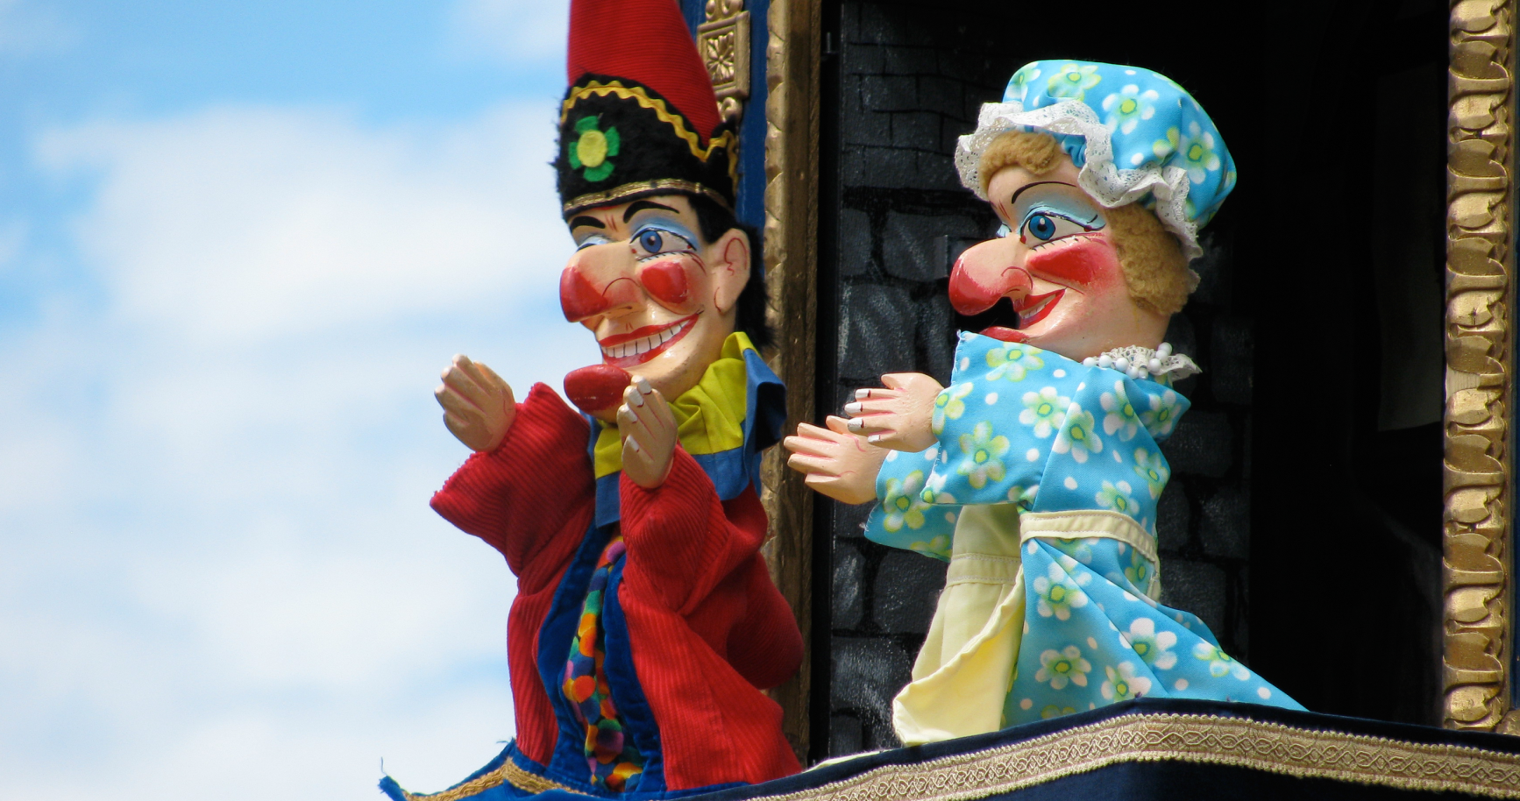
Punch and Judy
Photo courtesy of dpape (@flickr.com) - granted under creative commons licence – attribution

Slide 8
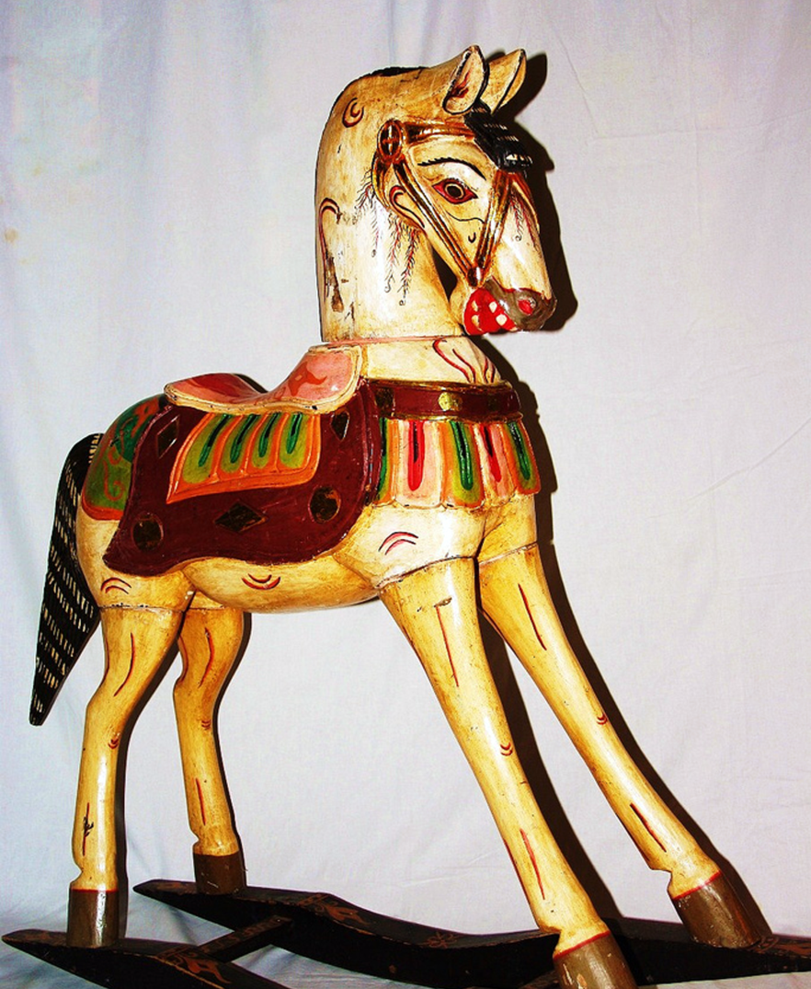
Rocking Horse
Photo courtesy of tourist on earth (@flickr.com) - granted under creative commons licence – attribution

Slide 9
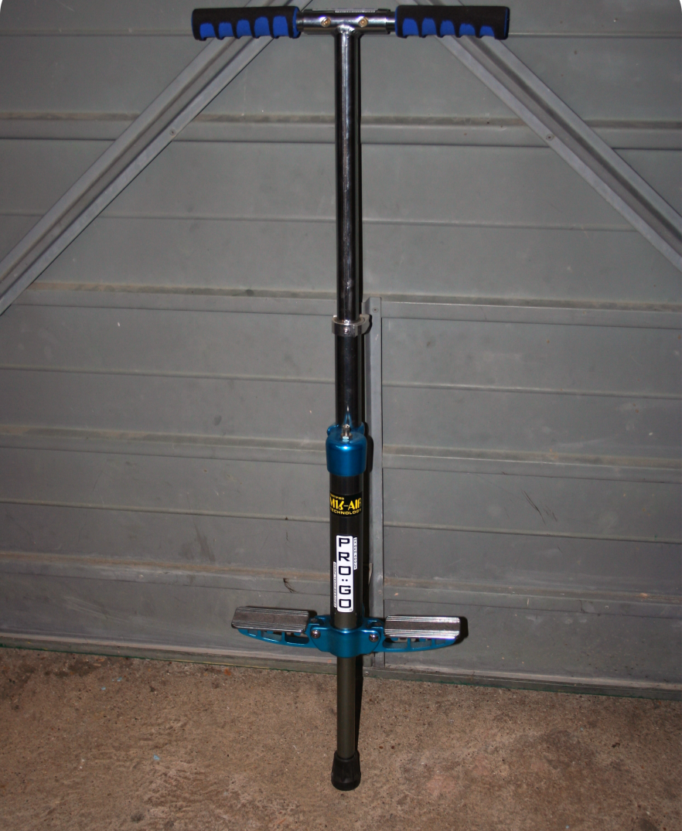
Pogo Stick
Photo courtesy of ndrwfgg (@flickr.com) - granted under creative commons licence – attribution

Slide 10
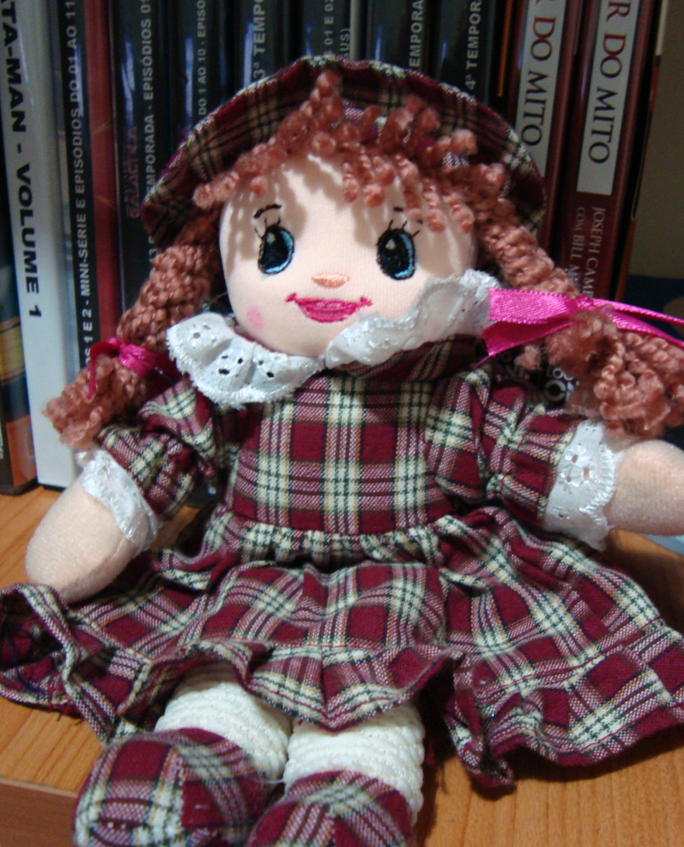
Rag Doll
Photo courtesy of Daniel Pixao Fontes (@flickr.com) - granted under creative commons licence – attribution

