Slide 1
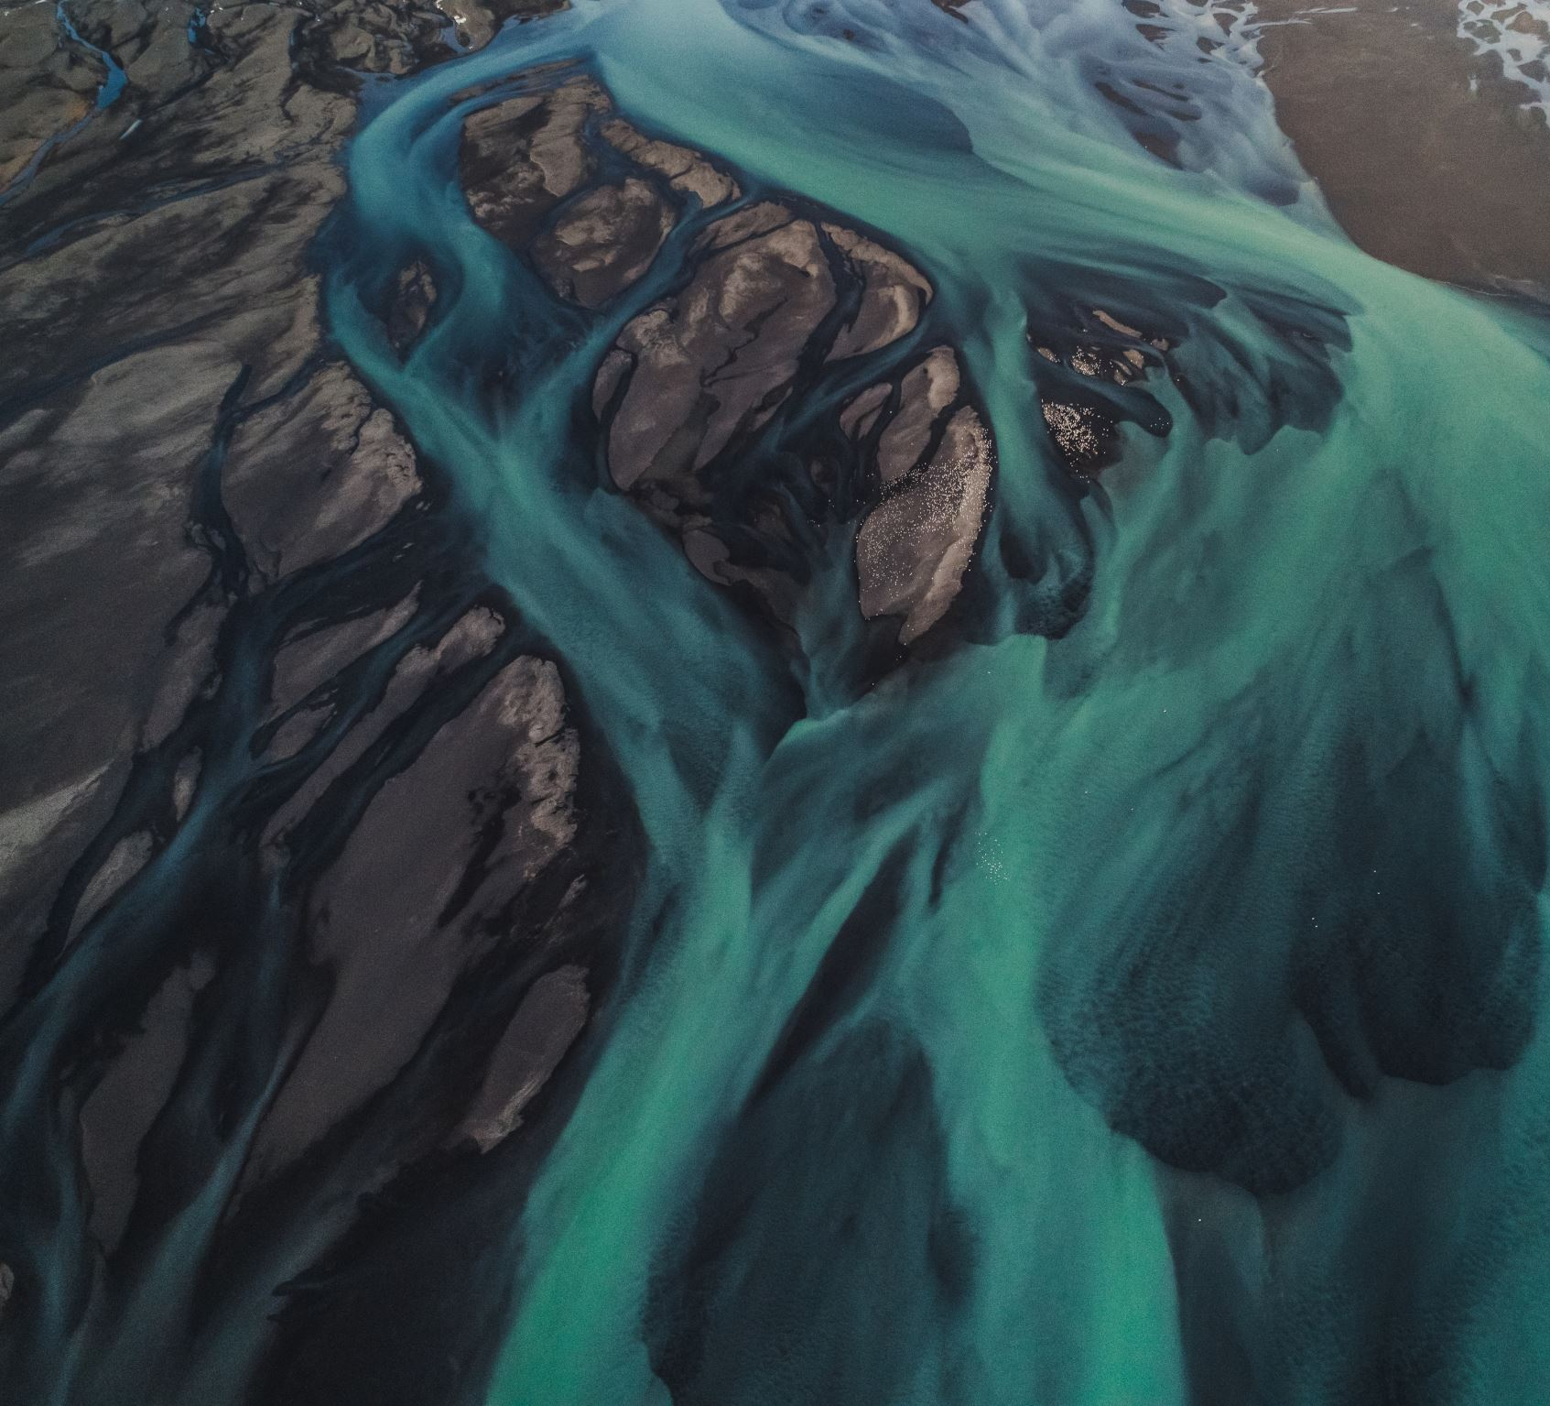
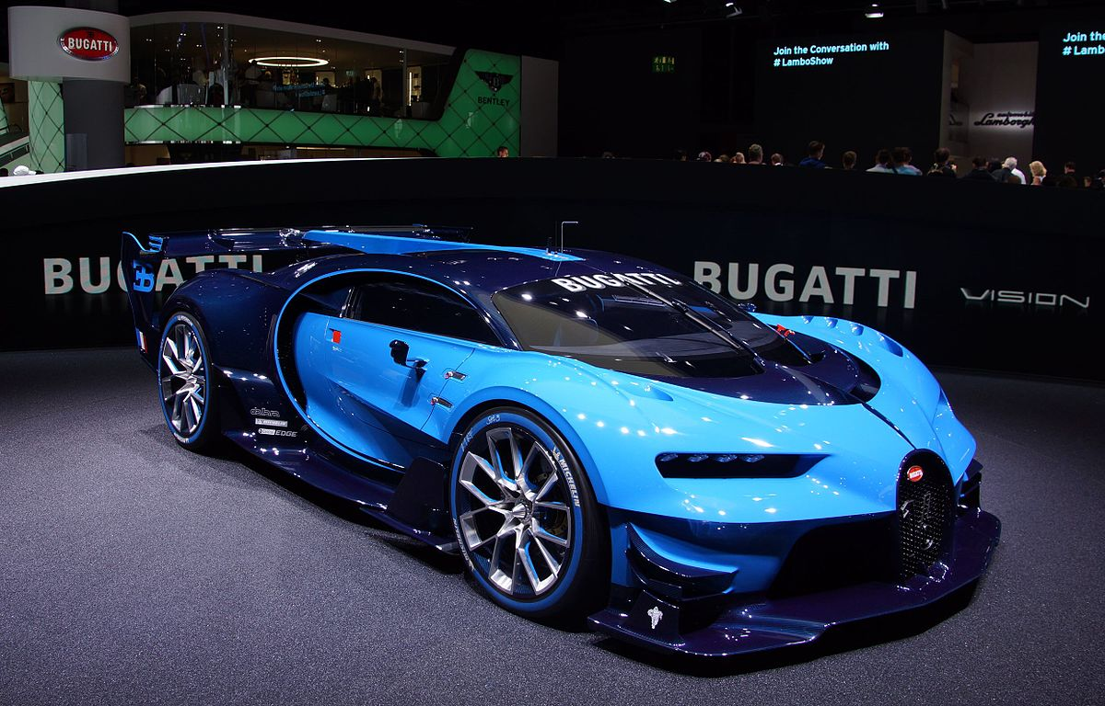
All about me.
This Photo by Unknown Author is licensed under CC BY-SA

Slide 2
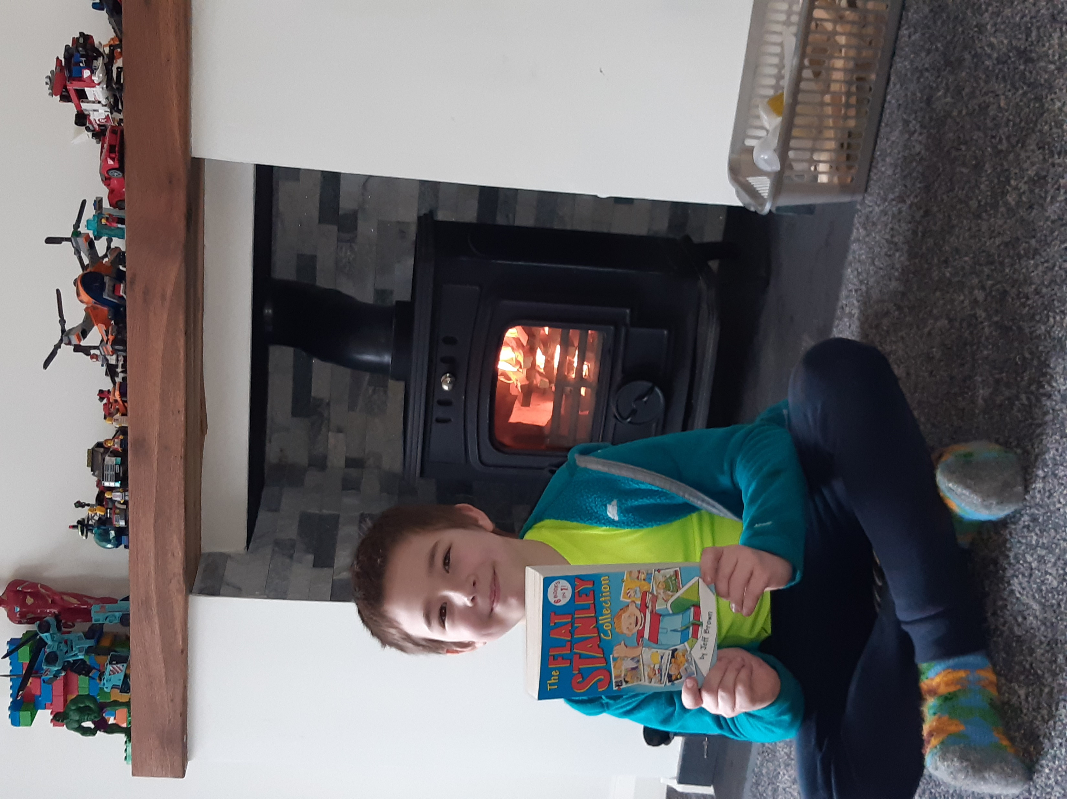
What I Do?
I would sometimes read when there would be no body else here.
I sometimes help my dad when he needs help.
I’d do some exercise when my homework was done.
It is so windy and yesterday my sister and my mom helped me and my dad cut the tree down.
Now I put my old sit up car seat up on the tree and then when I need to take a break I could sit on it.

Slide 3
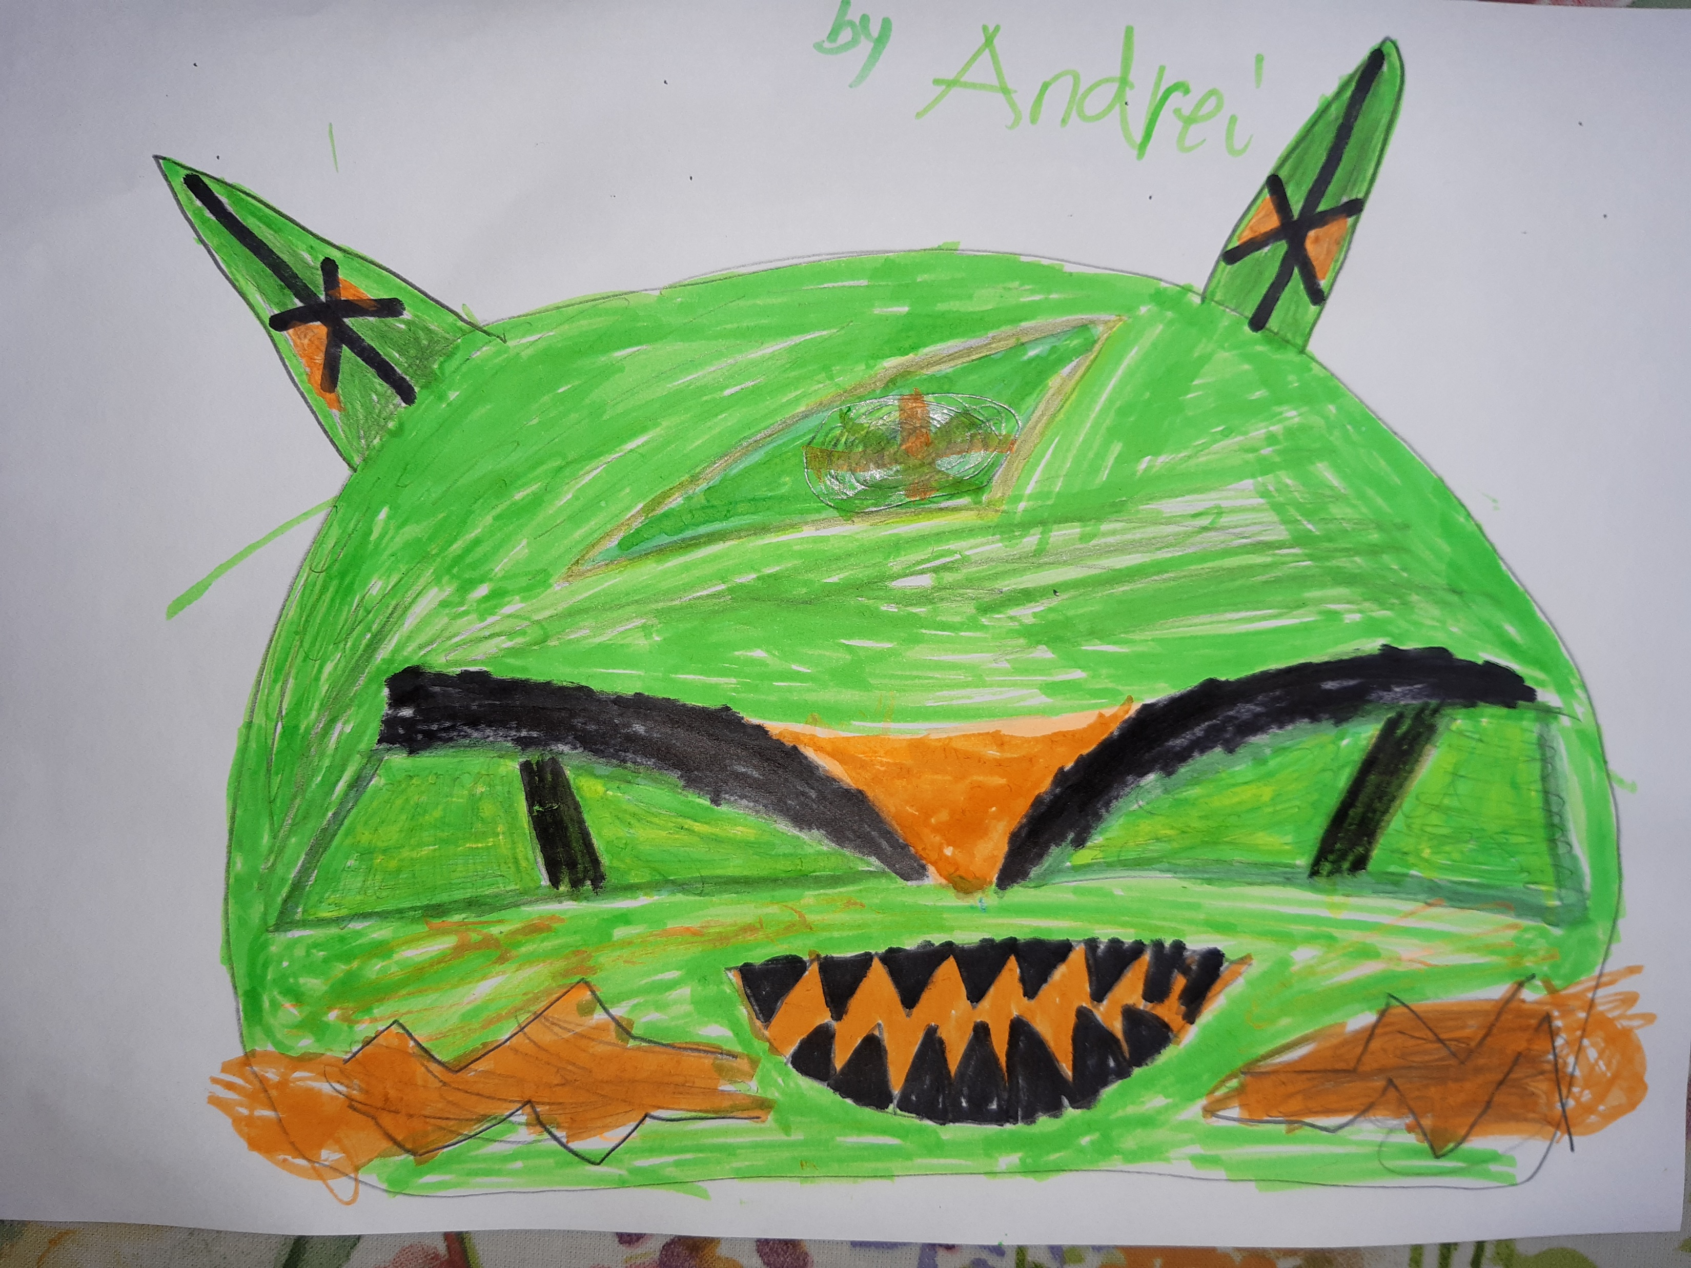
About Me.
I am eight years old.
I am 1.37m height.
I can climb trees.
I am good at drawing.

