Slide 1
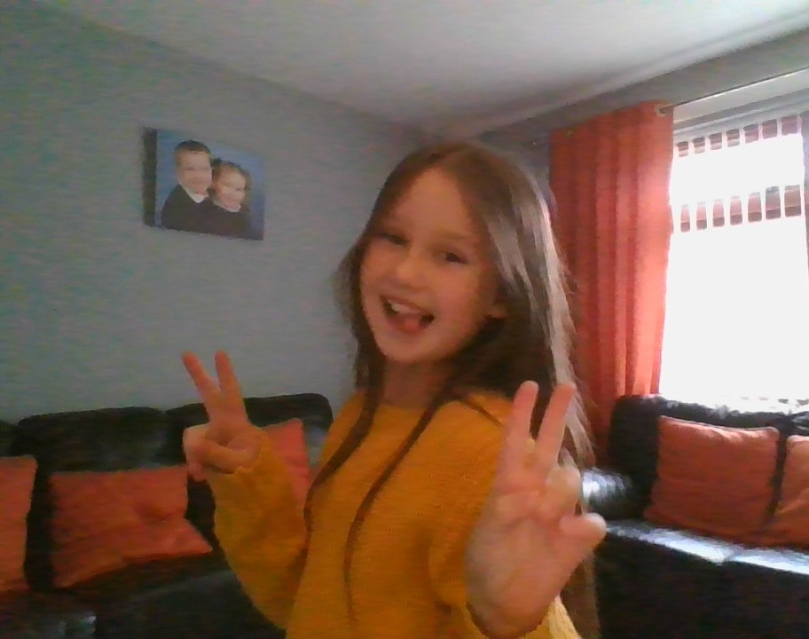
Grace
Mary
Donegan
All
about
me

Slide 2
My name is Grace Donegan. I am 8 years old. I live with my mum Nicola, my brother Brayden and my mums partner Thomas (who is just like a dad to me).
We live in an estate called Dunclug Park. I like where I live there is a small park just up the hill from my house, I play there with my friends. My best friend at home is Sofia, she lives just across the road from me. My granny is called Veronica, my granda is called Jimmy and I have two uncles called Mark and Terence. I love all my family very much and we are a very close family.

Slide 3
At the minute there is a global pandemic happening, so we can’t do all the normal stuff we enjoy but these are the things I like to do and enjoy doing.
Likes/ Interests
I like spending time with my family
I love to go shopping
I enjoy going out for dinner
I love to meet up with my friends and play
I love to do my make up, hair and nails
Hobbies
Gymnastics
Irish dancing
Cheerleading
Going on my hover board
Playing on my bike
Walking

Slide 4
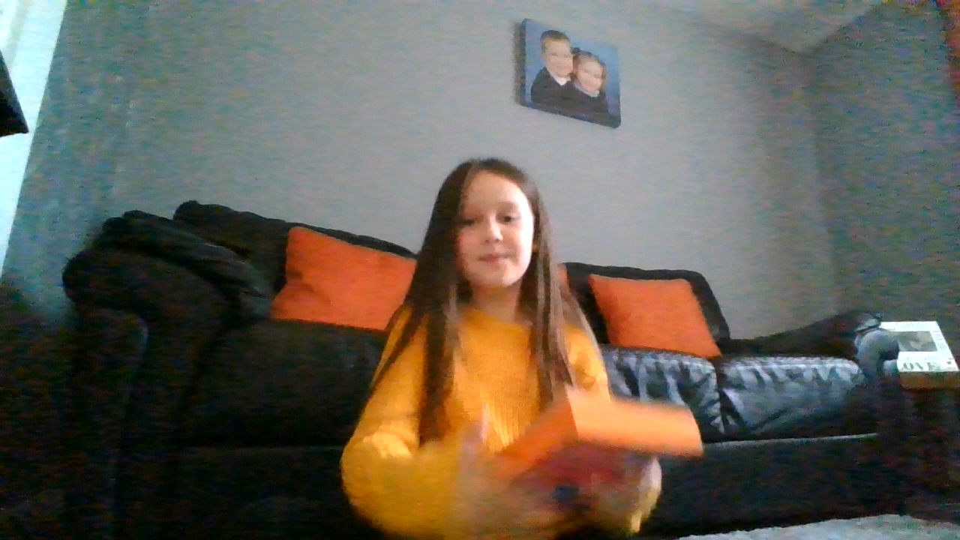
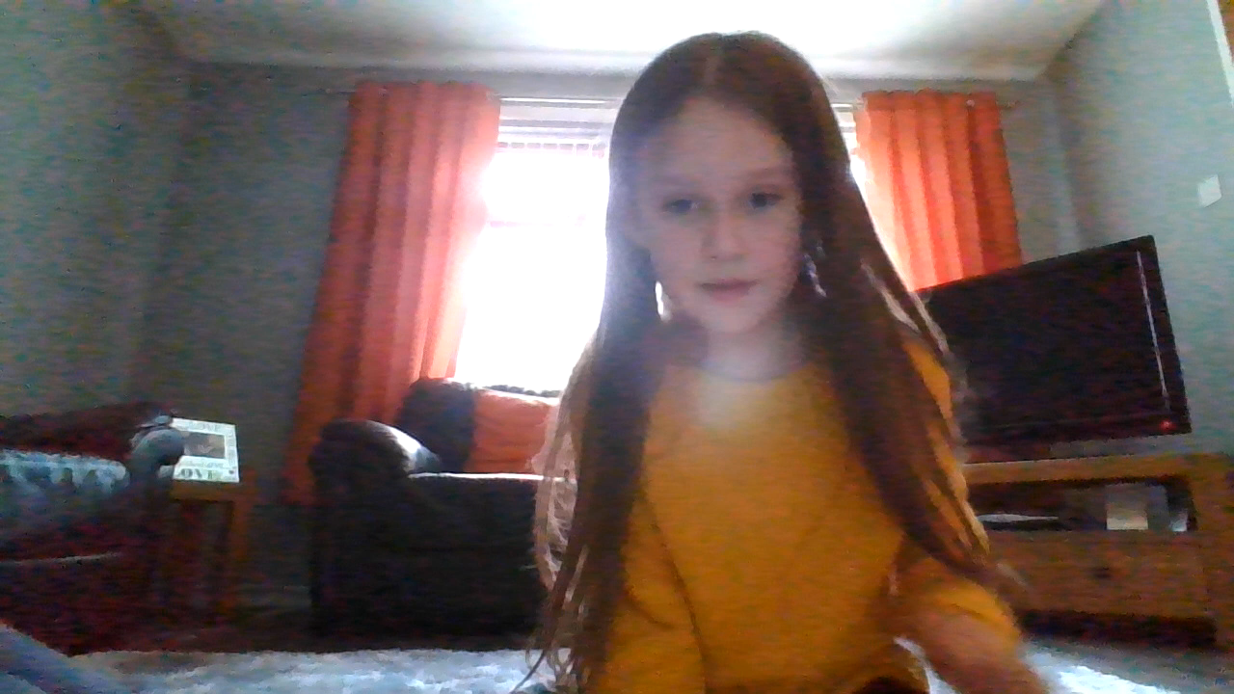
I enjoy reading, dancing and keeping active

