Slide 1
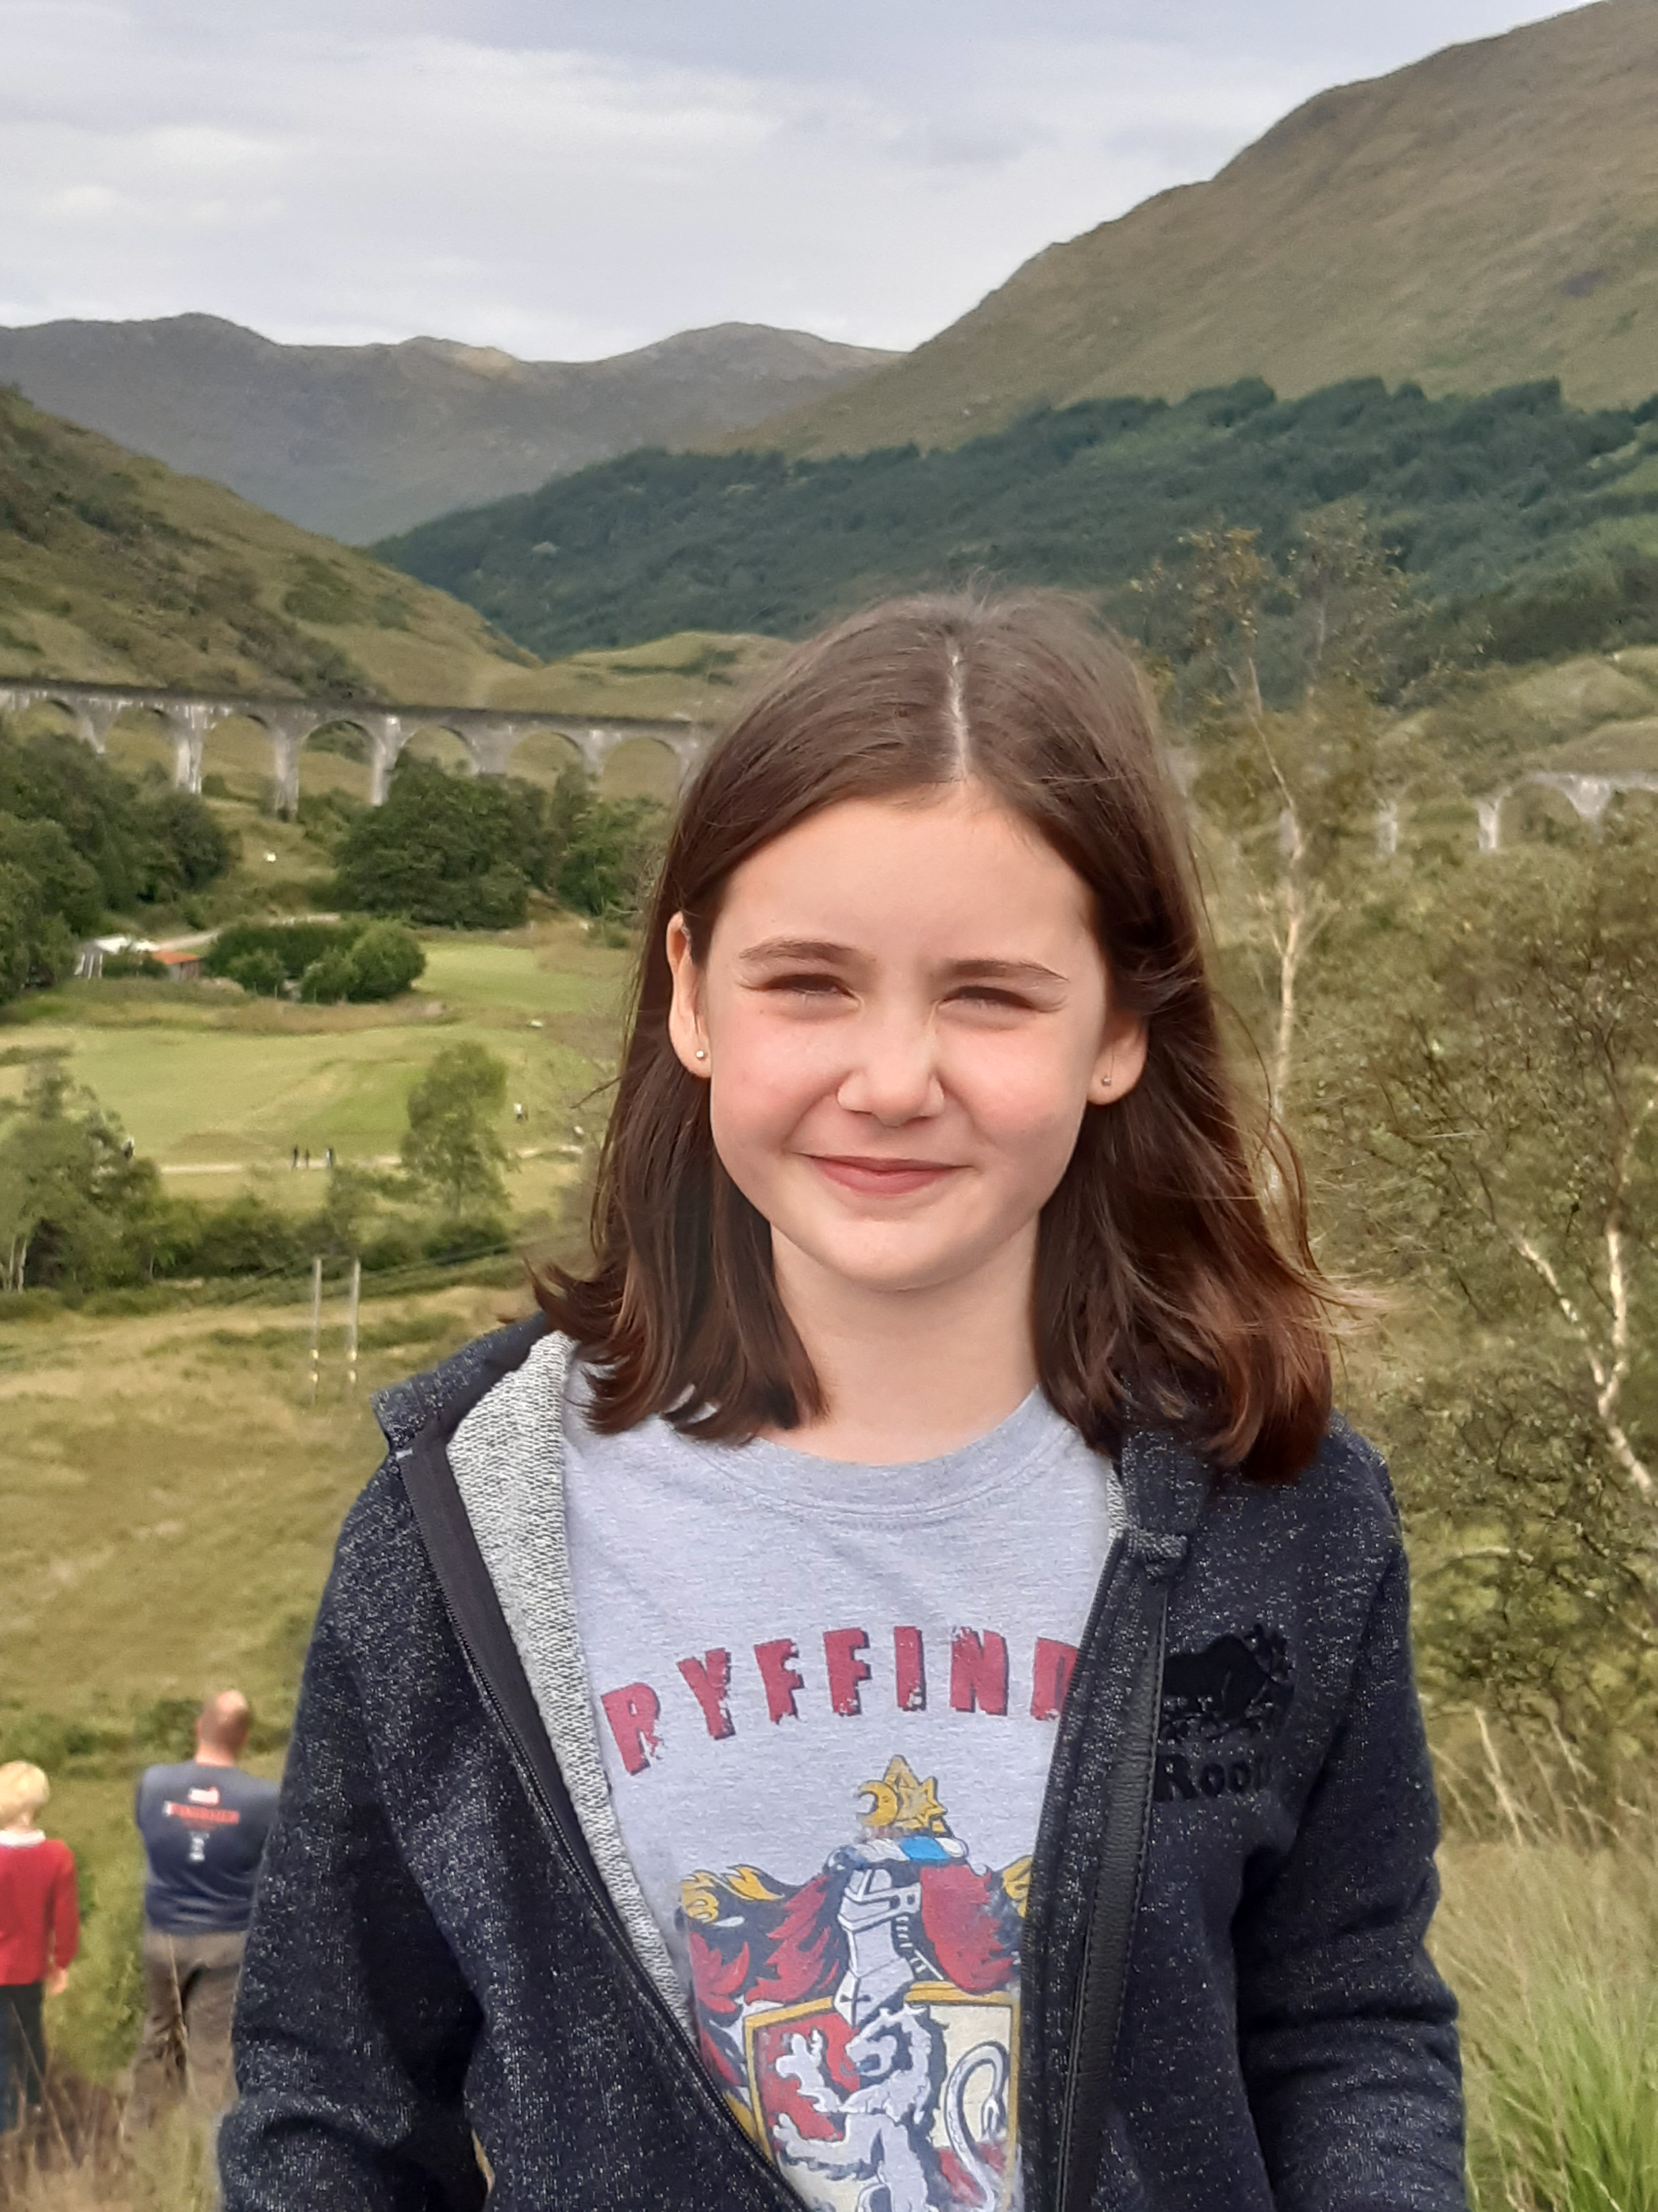
All About Me
By Regan Loughran

Slide 2
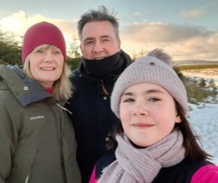
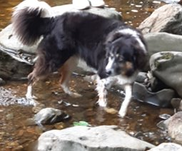
Hi, my name is Regan Loughran, and I am 9 years old.​
I live with my parents and our Border Collie dog, Bruce.​

Slide 3
I like to express myself in many ways.
Come on and I'll share these with you!

Slide 4
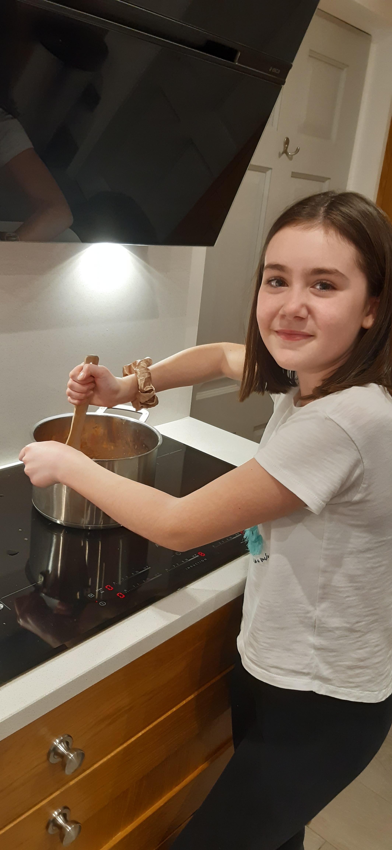
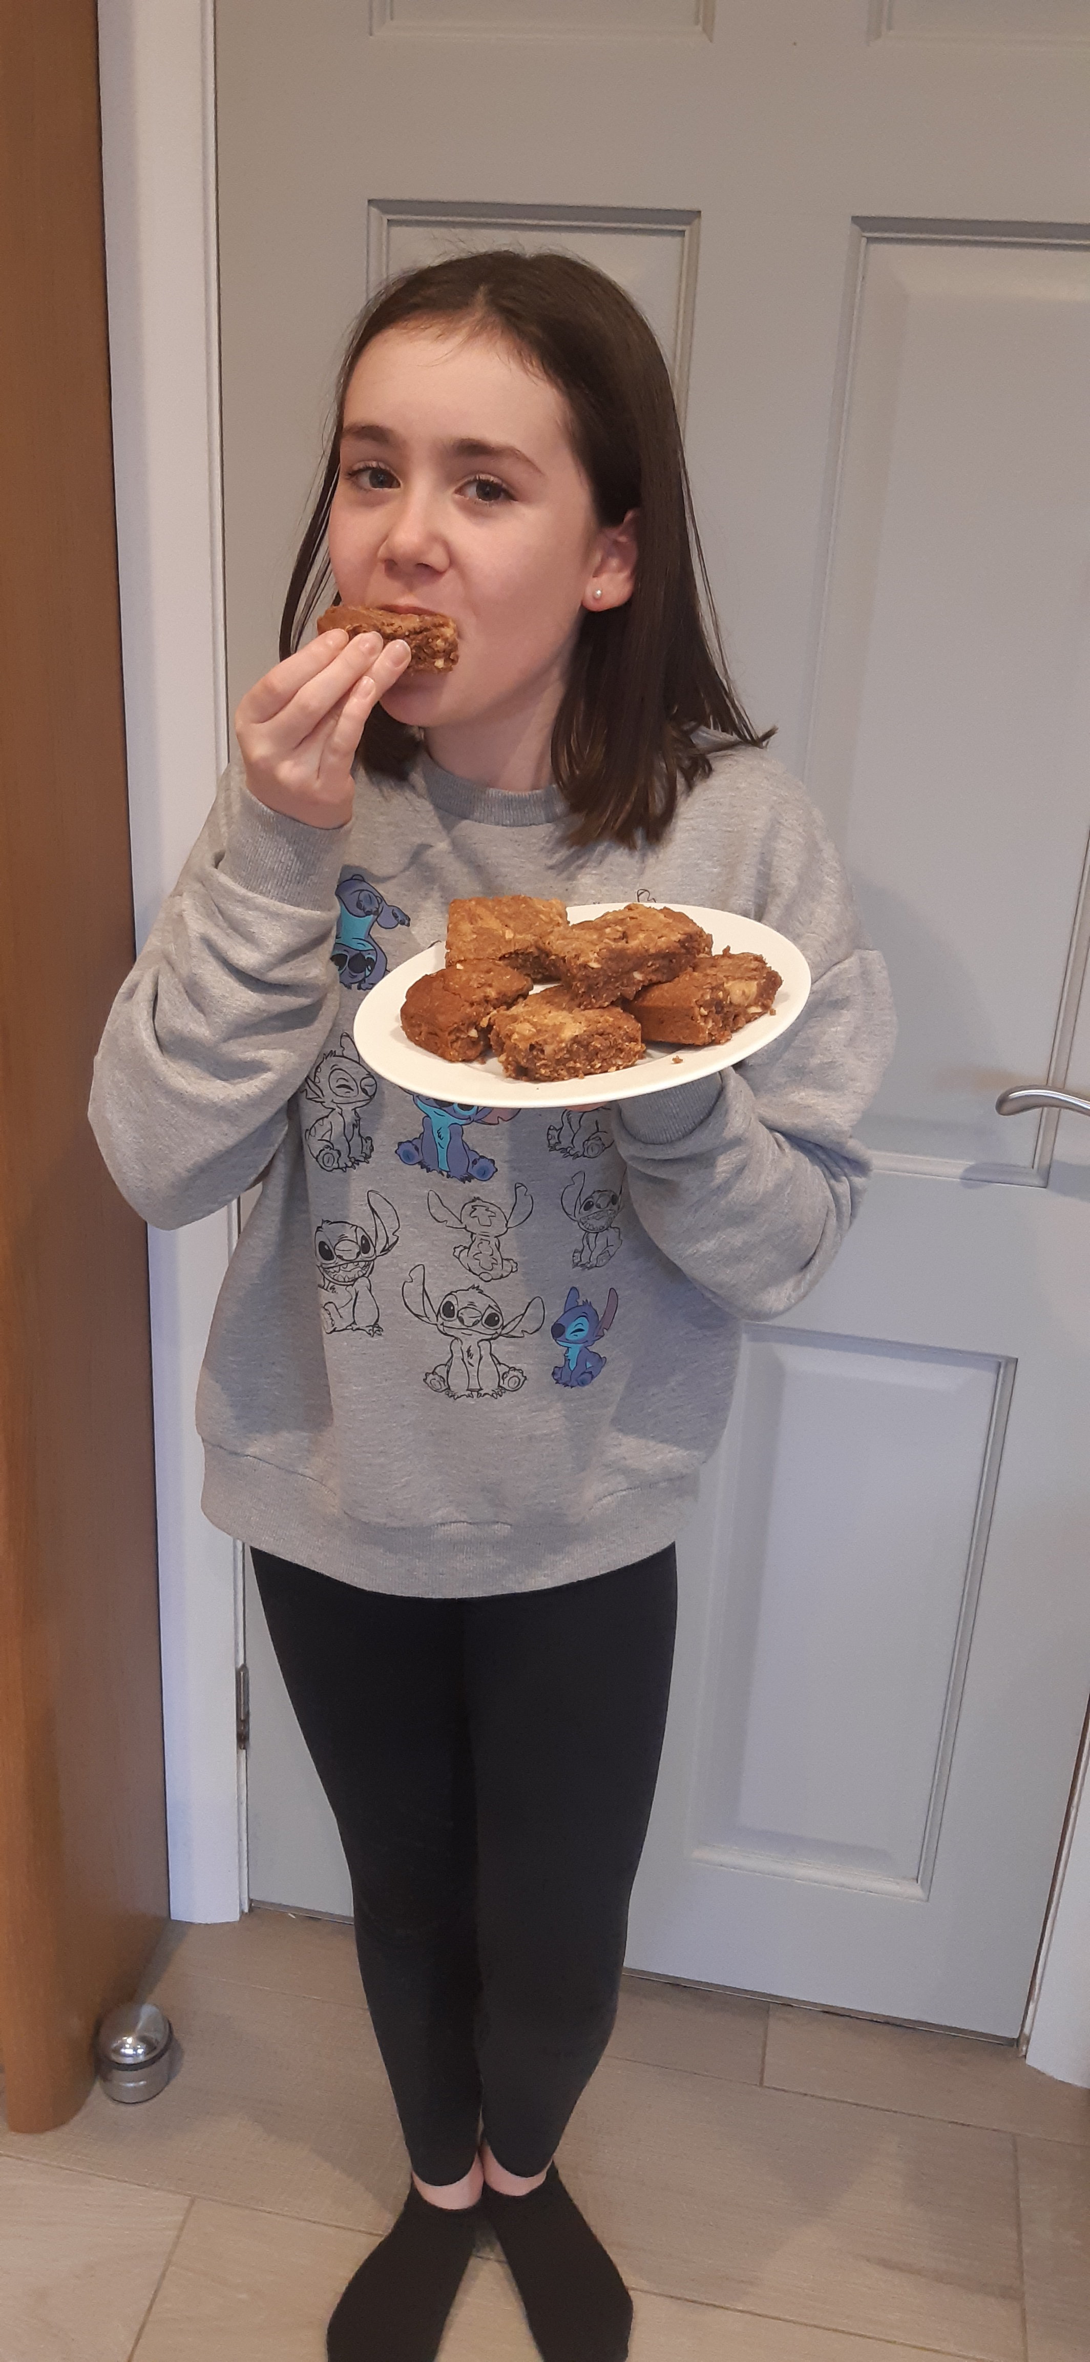
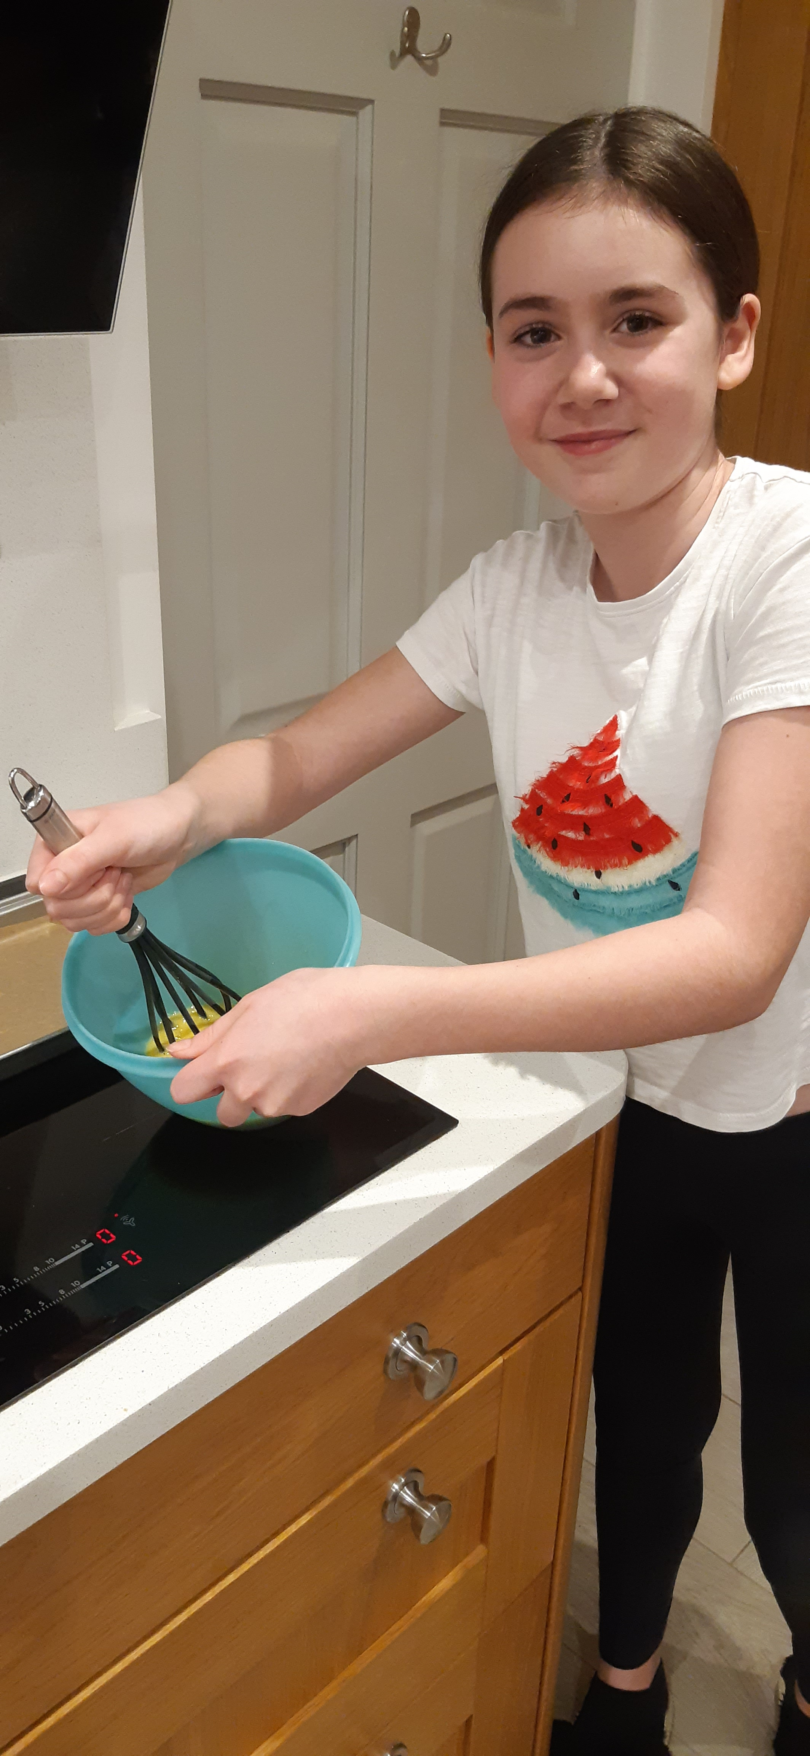
I like to be creative through cooking and baking.
I enjoy the fact that I can let my imagination run wild with the decoration and adding flavours, mmmmmmmmmm!
My favourite things to make are vegetable soup, spicy chicken pieces, banana bread and brownies. Yum!

Slide 5
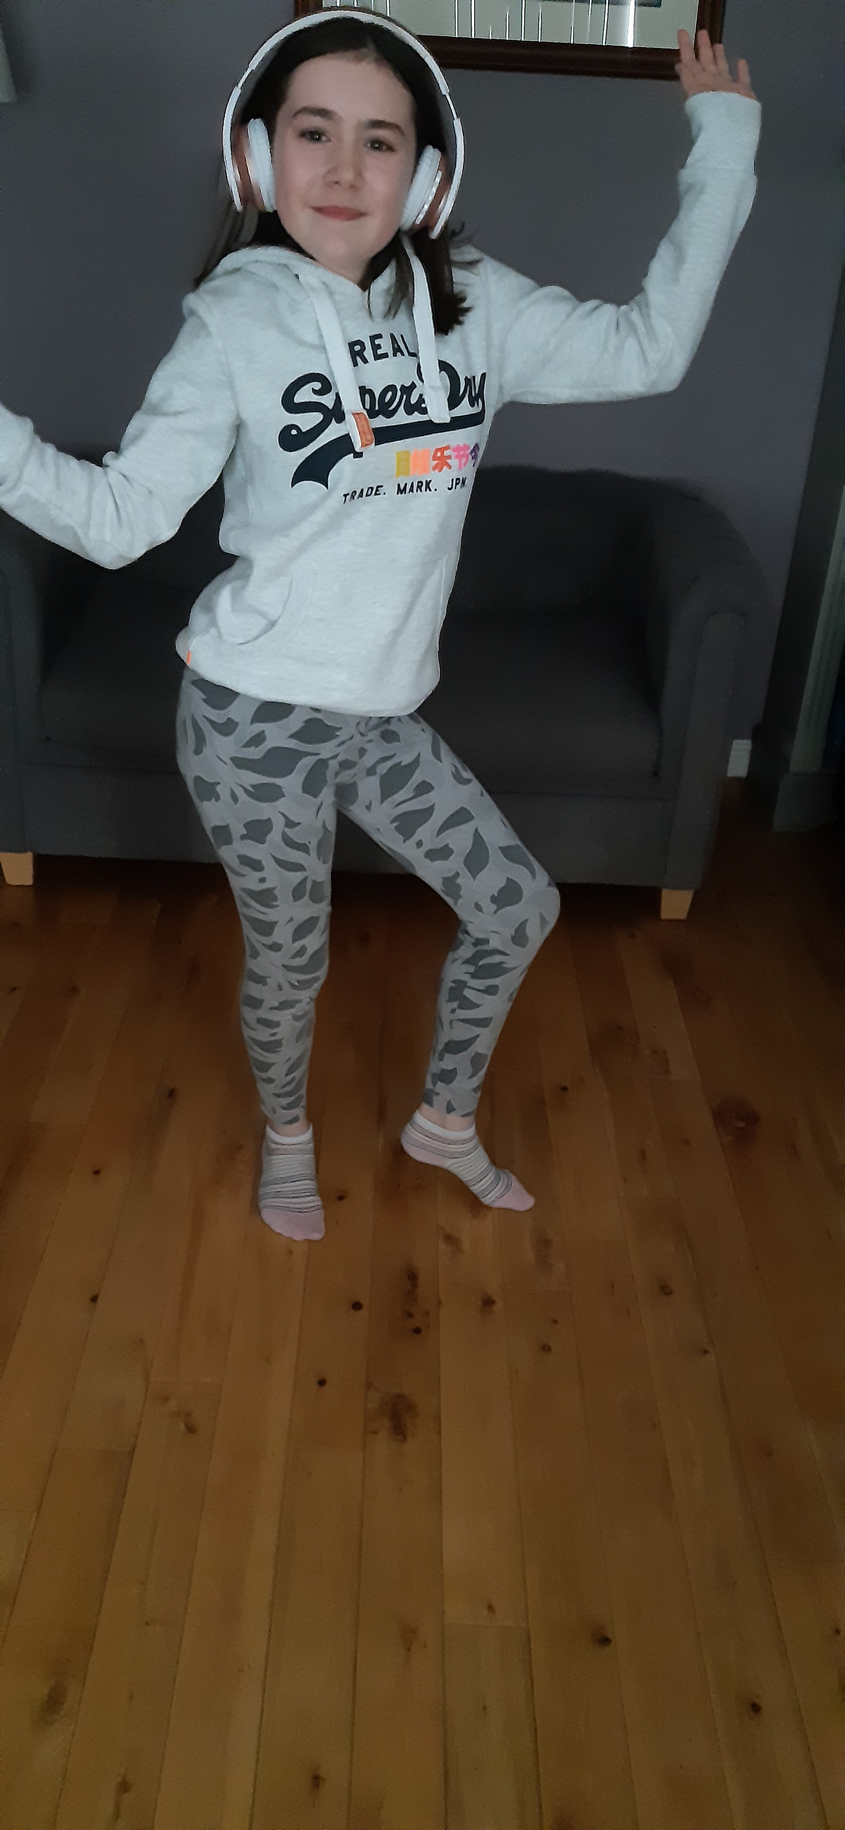
Listening to music makes me feel relaxed and happy. When I feel the beat, I just can't stop my feet from dancing!
Some of my favourite artists are: Little Mix; Ed Sheeran; Anne Marie; Sia and Marshmello.

Slide 6
Another way I like to express myself is by going to Belfast School of Performing Arts (Ballymena School) on Saturdays with my friends.
We learn how to sing, act and dance. I love the excited feeling I get performing in front of an audience but sometimes I can get very shy as well.
Before the Covid 19 pandemic, I played the Munchkin Coroner in a performance of The Wizard Of Oz. It made me feel proud!
Because of the current Covid 19 restrictions our classes are held on Zoom.

Slide 7
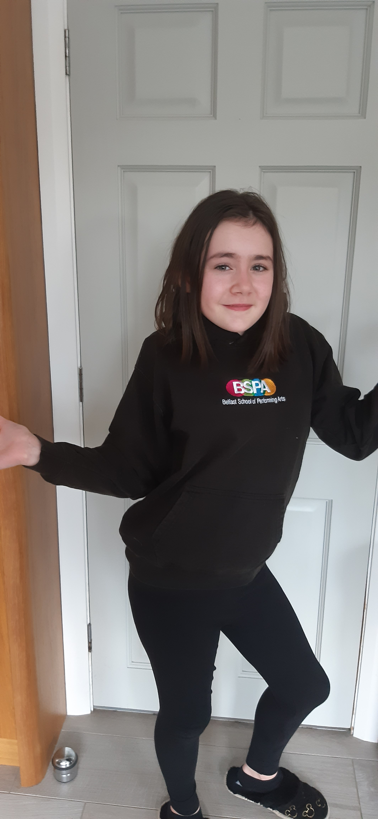
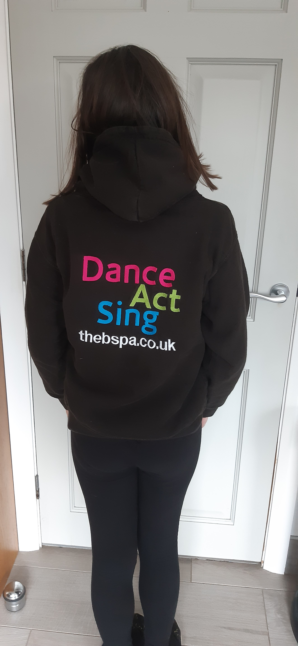
Here are some photos.

Slide 8
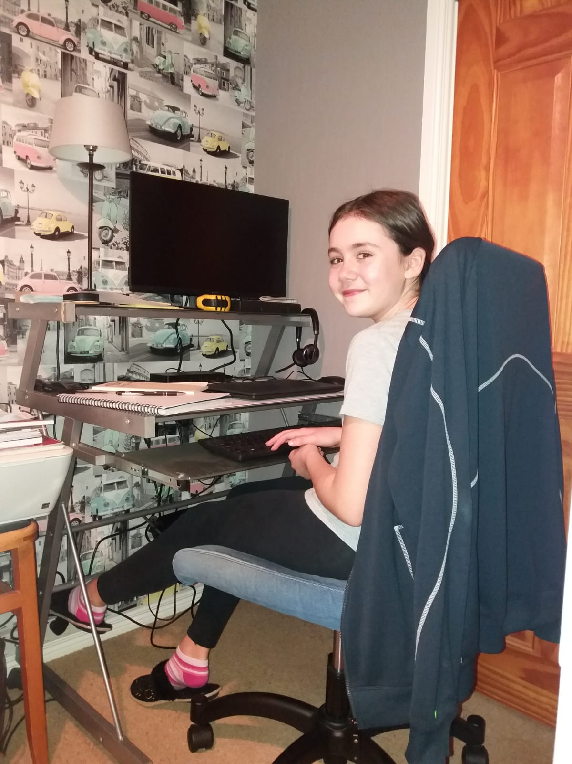
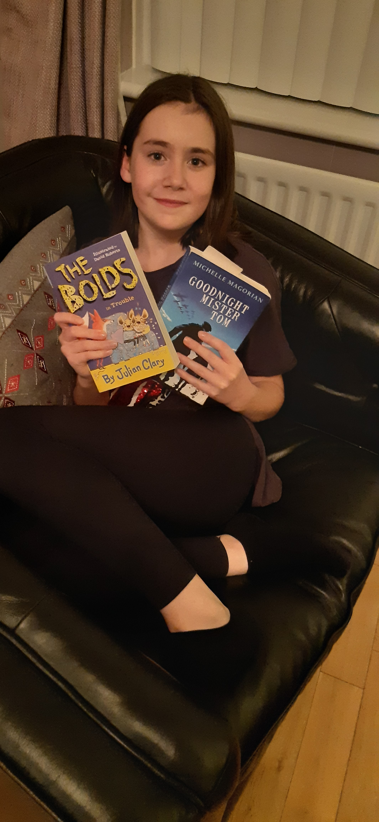
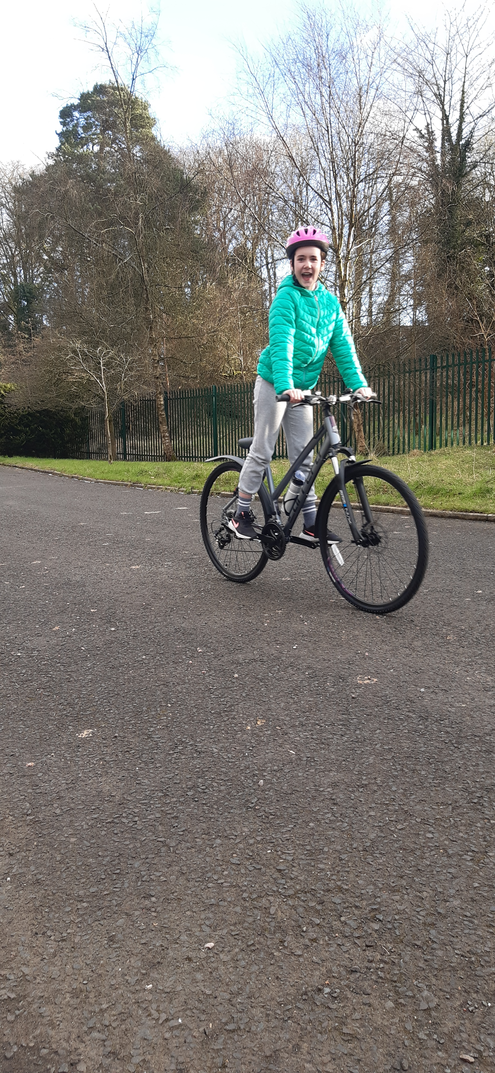
At home I like to express myself by reading, riding my bicycle, skipping and playing outside.
I also like doing roleplays with my family such as pretending I work in a hotel and restaurant.

Slide 9
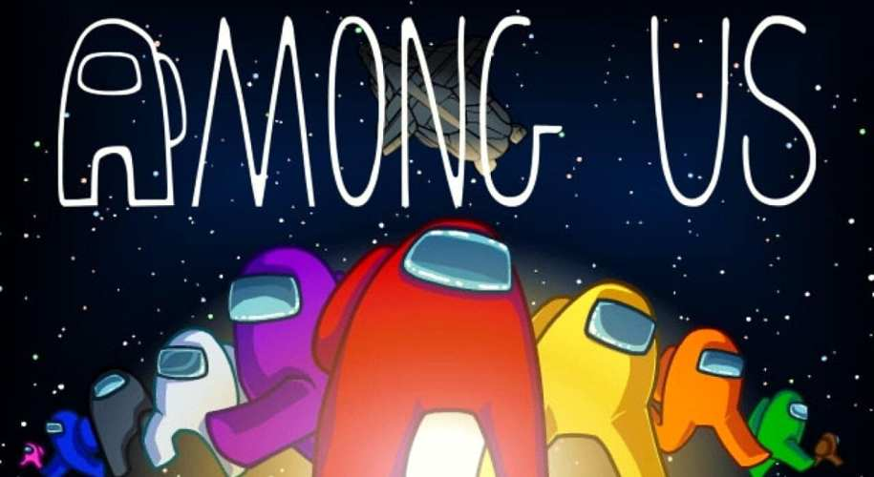
Other times I play games like Among Us and Roblox with my friends and family.
This has been a fun way to stay in touch during lockdown. ​

Slide 10
I like to travel to see what other countries are like and how the people there live. The countries I have visited include:
Sweden Denmark Croatia France England Scotland Ireland
I can't wait until we are able to travel again, because I enjoy meeting people and experiencing different foods, languages and culture.

Slide 11
Well, that tells you lots about me and how I like to express myself. I hope you enjoyed it and I welcome any feedback on my presentation.
Thanks,
Regan.

