Slide 1
All About Me
BY JACOB RYAN

Slide 2
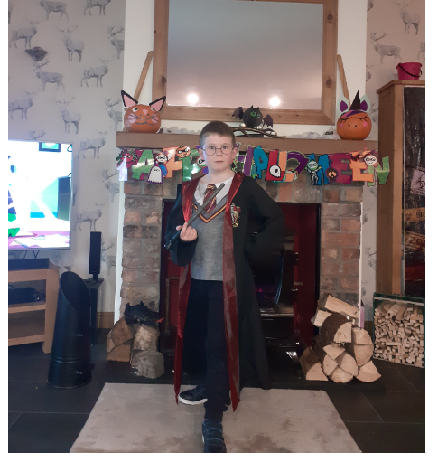
This is a little bit about me, enjoy…
School Life
My Family
Home Life
My Likes
My hobbies

Slide 3
Introduction and school life
My name is Jacob and I am 8 years old.
I go to Braidside Integrated primary school and my class is p5\6F, we are known as the Incredibles.

Slide 4
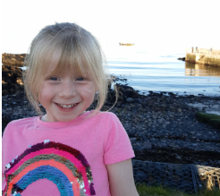
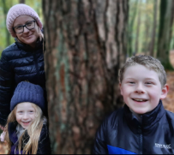
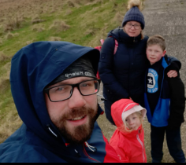
MY FAMILY
I live with my mum, dad and sister Lily.

Slide 5
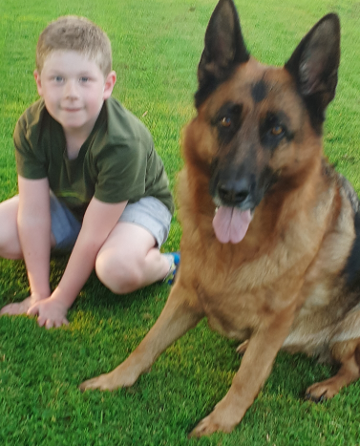
HOME LIFE
I have two dogs who are very friendly, love treats and walks.
Their names are Poppy the cute German Shepard and Buddie the ankle biter Schnauzer. Just a joke, he doesn’t really bite ☺

Slide 6
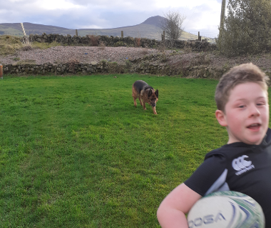
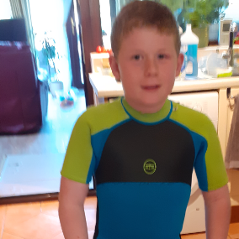
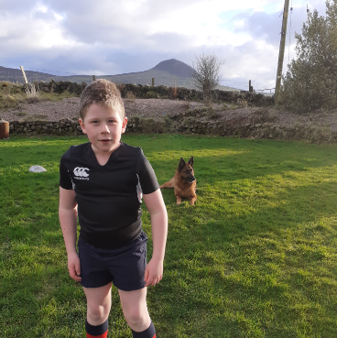
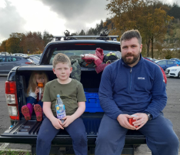
My Likes
We love to spend time in our caravan, when I’m not playing rugby for Ballymena Rugby Club!

Slide 7
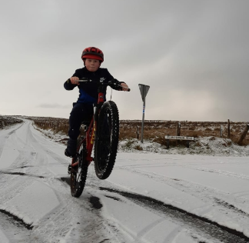
My Hobbies
Alongside rugby, my favorite thing to do is wheelies on my bike in the snow and going to the skate park. For a little treat I get to play my Nintendo Switch.

Slide 8
THE END
Thank you for reading,
Jacob Ryan.

