Slide 1
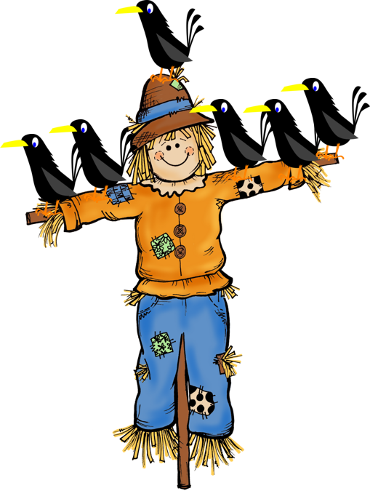

Teacher of English
Collective Nouns
English Teaching Resources

Slide 2
What are we learning?
Today we are going to learn all about collective nouns.

Slide 3
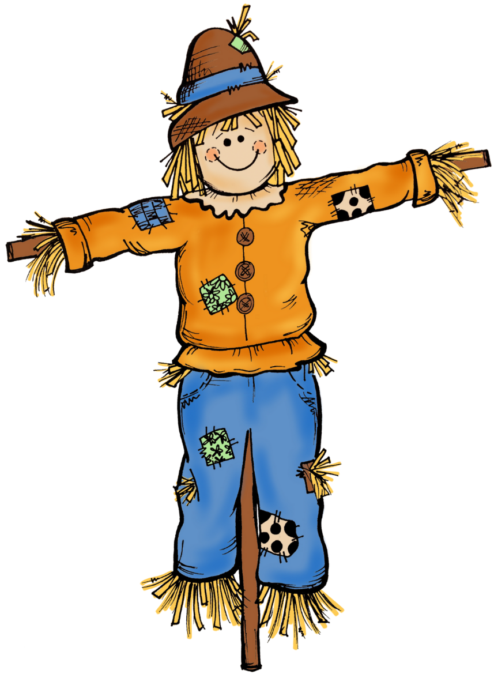
What is a collective noun?

Slide 4
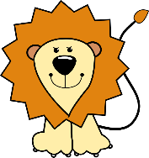
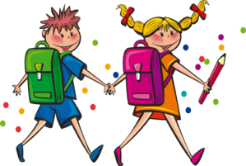
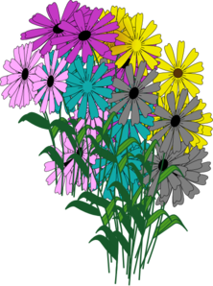
A collective noun is the name given to a group of things.
It can be a group of animals such as lions
It can be a group of people such as students
It can be a group of things such as flowers

Slide 5
Can you think of any collective nouns for groups of people?

Slide 6
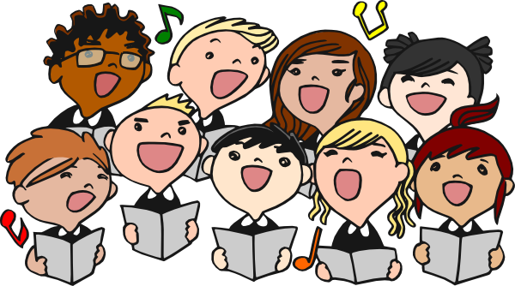
A choir of singers.

Slide 7
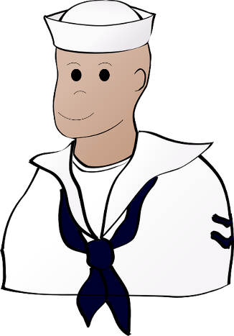

A crew of sailors.

Slide 8
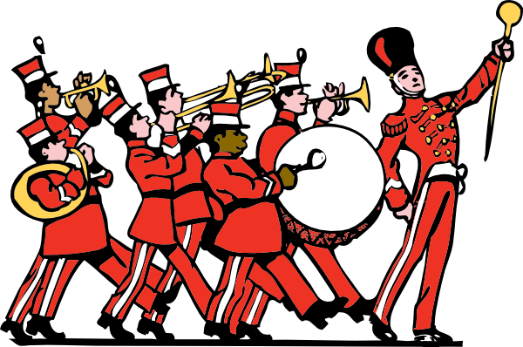
A band of musicians.

Slide 9
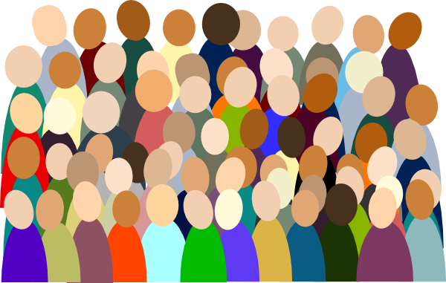
A crowd of people.

Slide 10
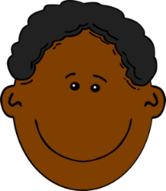


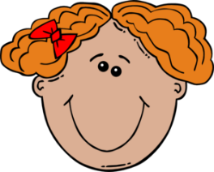
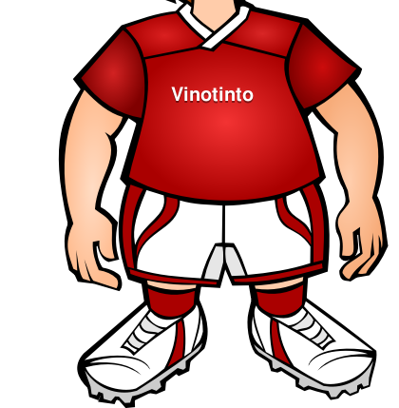
A team of players.

Slide 11
Can you think of any collective nouns for groups of animals?

Slide 12
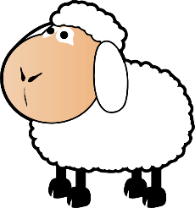
A flock of sheep.

Slide 13


A swarm of bees.

Slide 14
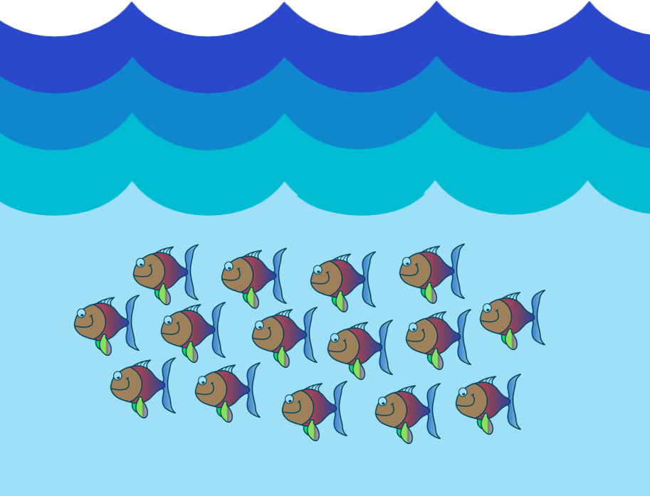
A school of fish.

Slide 15

A herd of elephants.

Slide 16
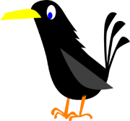
A murder of crows.

Slide 17
Can you think of any collective nouns for groups of things?

Slide 18

A bunch of grapes.

Slide 19

A range of mountains.

Slide 20
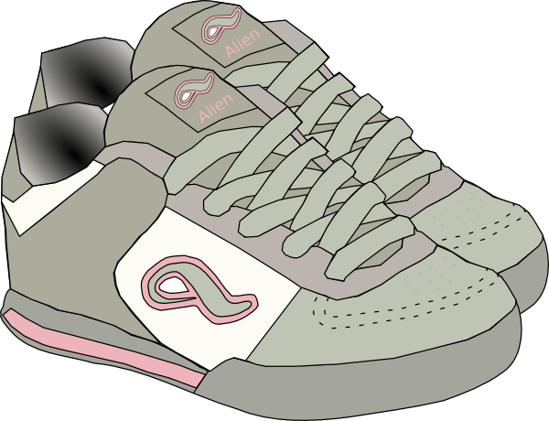
A pair of shoes.

Slide 21
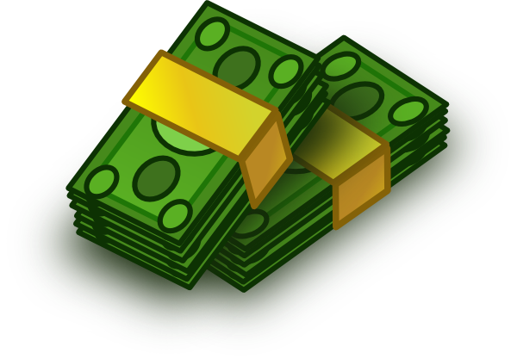
A wad of notes.

Slide 22


A fleet of ships.

Slide 23
Choose the correct noun to complete the phrase on each slide. Click on the _ _ _ to reveal the answer.

Slide 24

keys cricketers lions soldiers
kittens students trees wolves
a team of cricketers

Slide 25
keys cricketers lions soldiers
kittens students trees wolves
a forest of trees

Slide 26
keys cricketers lions soldiers
kittens students trees wolves
a litter of kittens

Slide 27
keys cricketers lions soldiers
kittens students trees wolves
an army of soldiers

Slide 28
keys cricketers lions soldiers
kittens students trees wolves
a pride of lions

Slide 29
keys cricketers lions soldiers
kittens students trees wolves
a bunch of keys

Slide 30
keys cricketers lions soldiers
kittens students trees wolves
a class of students

Slide 31
keys cricketers lions soldiers
kittens students trees wolves
a pack of wolves

Slide 32

Add a suitable collective noun to complete the sentences below.
The _______ of soldiers marched over the hill.
A large _______ of spectators cheered loudly.
A ______ of wolves live in the wood.
Meera gave her mum a _______ of flowers.
The _______ of fish swam away quickly.
The policeman had a large ______ of keys.
A _______ of elephants rampaged through the village.
The children were attacked by a _______ of wasps.
Sally looked out of the window when a ______ of seagulls flew by.
The ______ of musicians played excitedly.
Remember: a collective noun is the name for a group of something.

