Slide 2
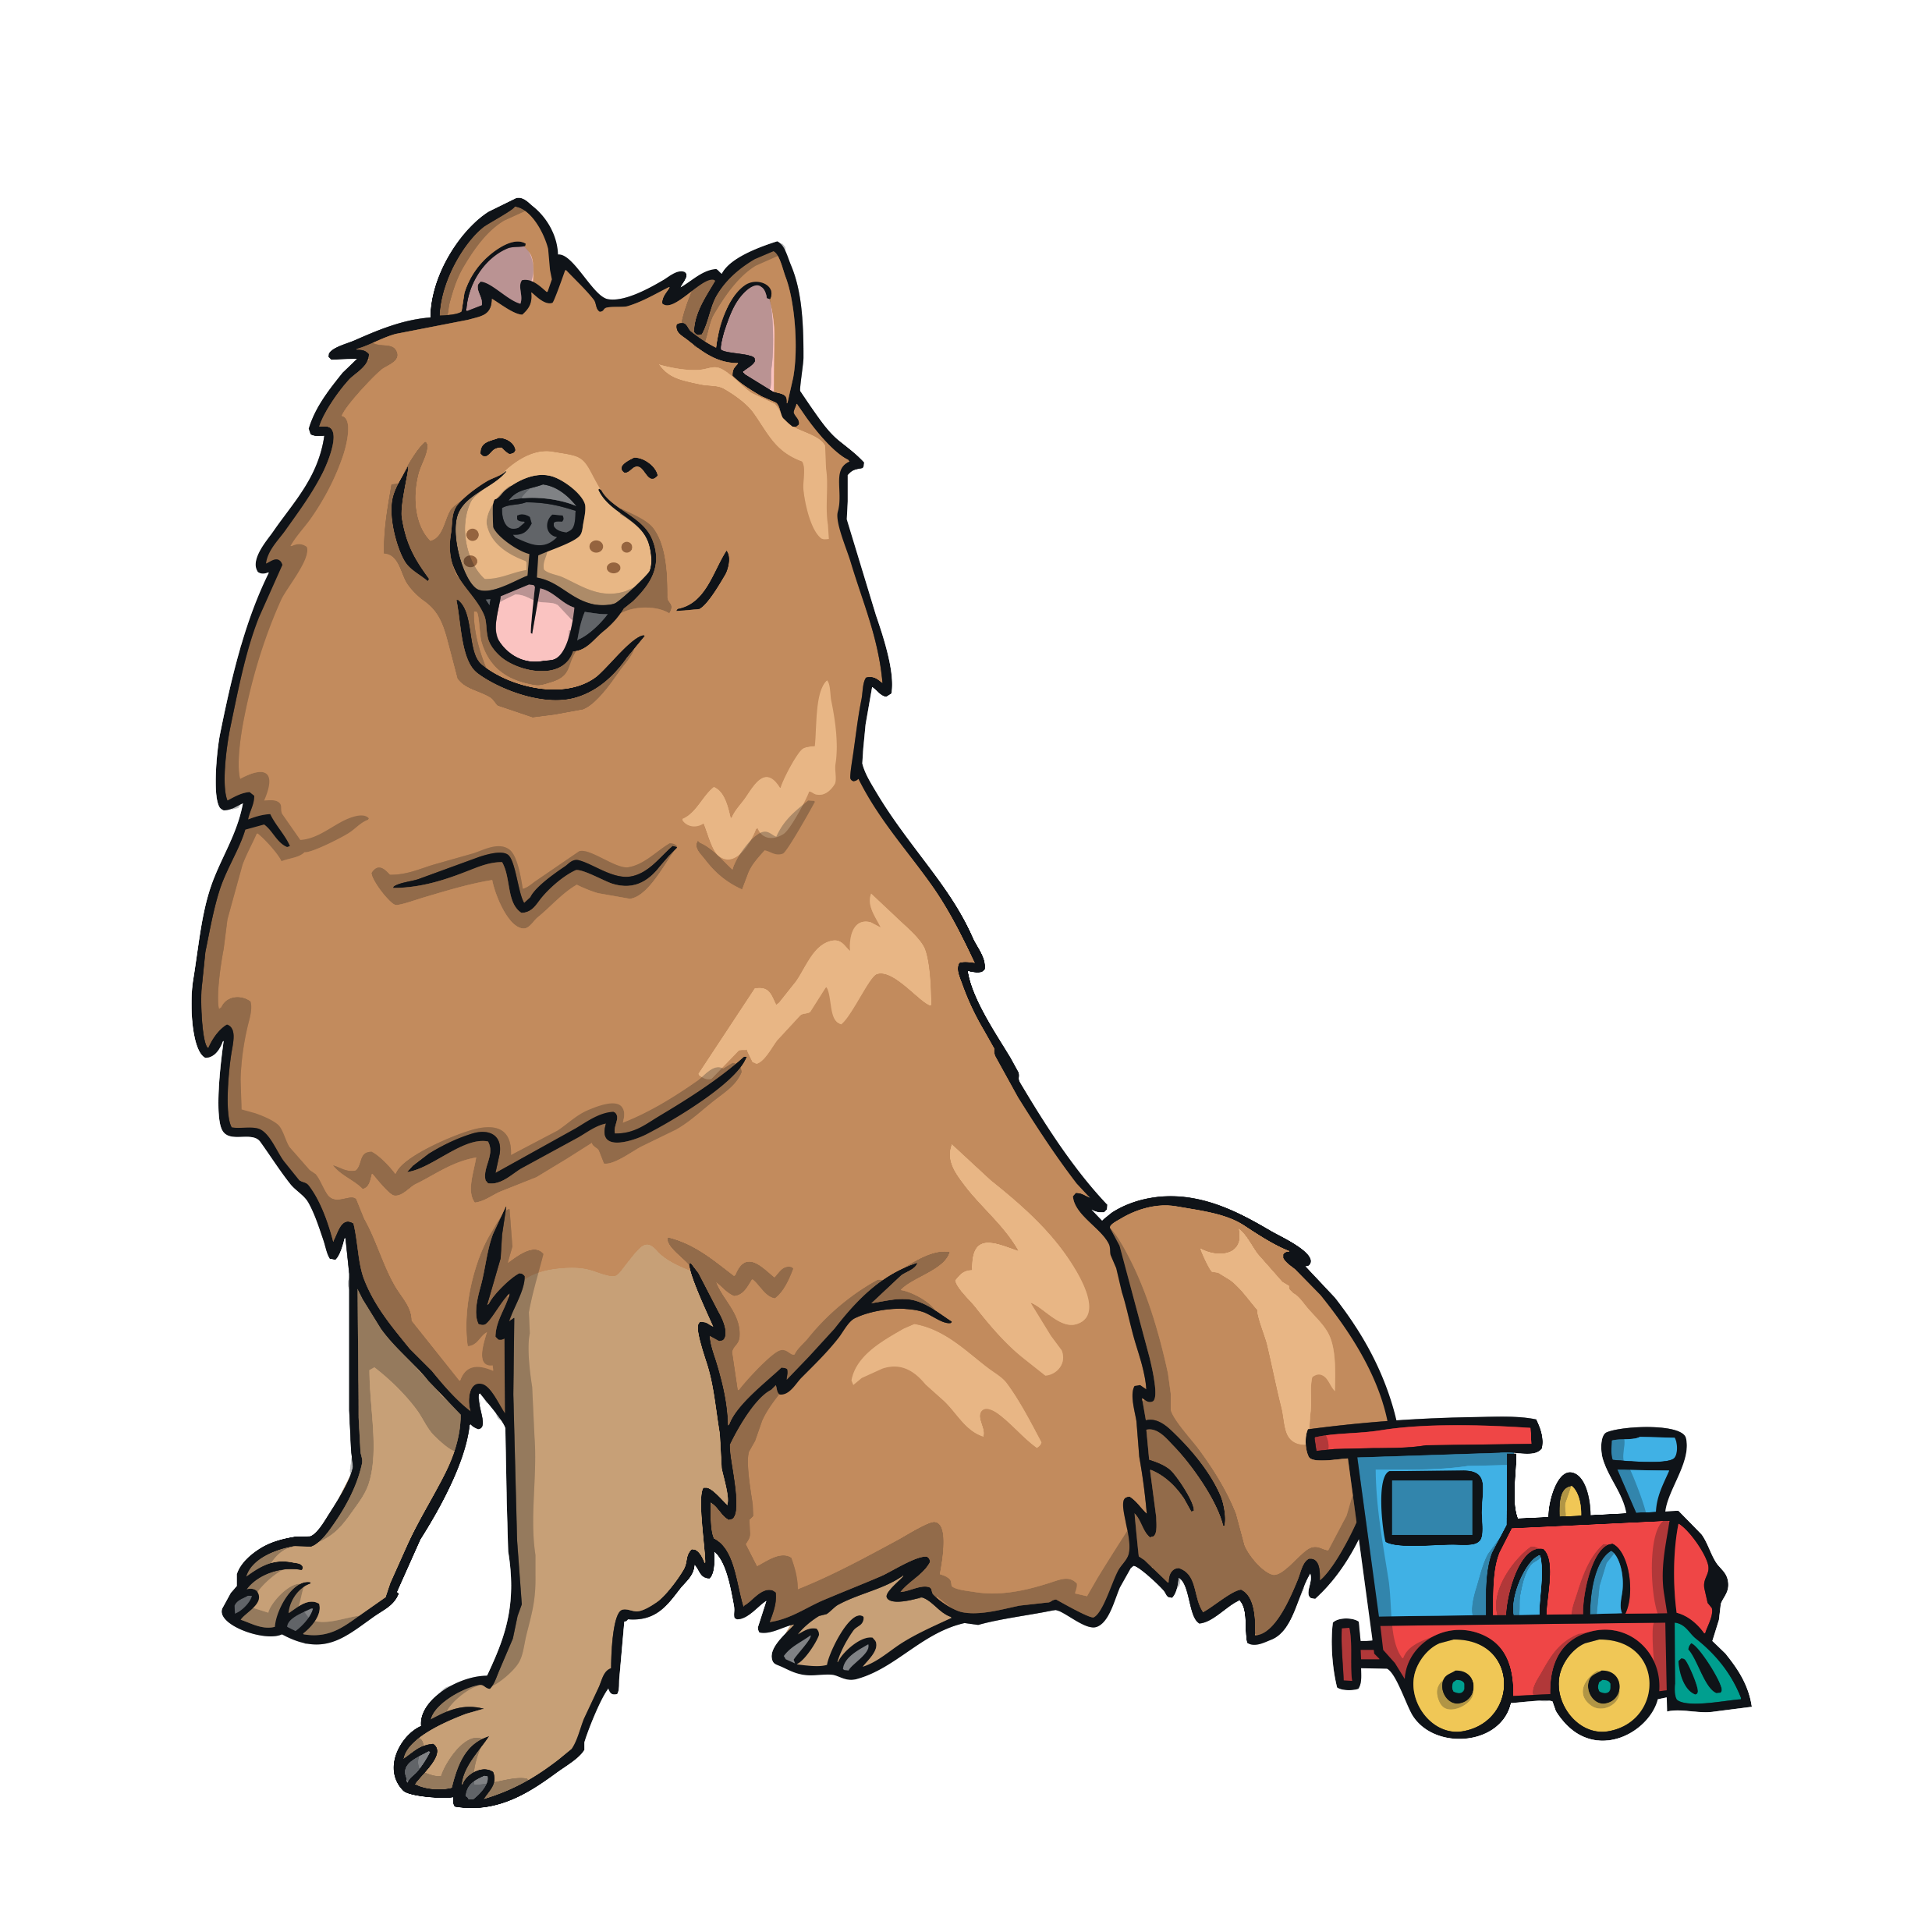
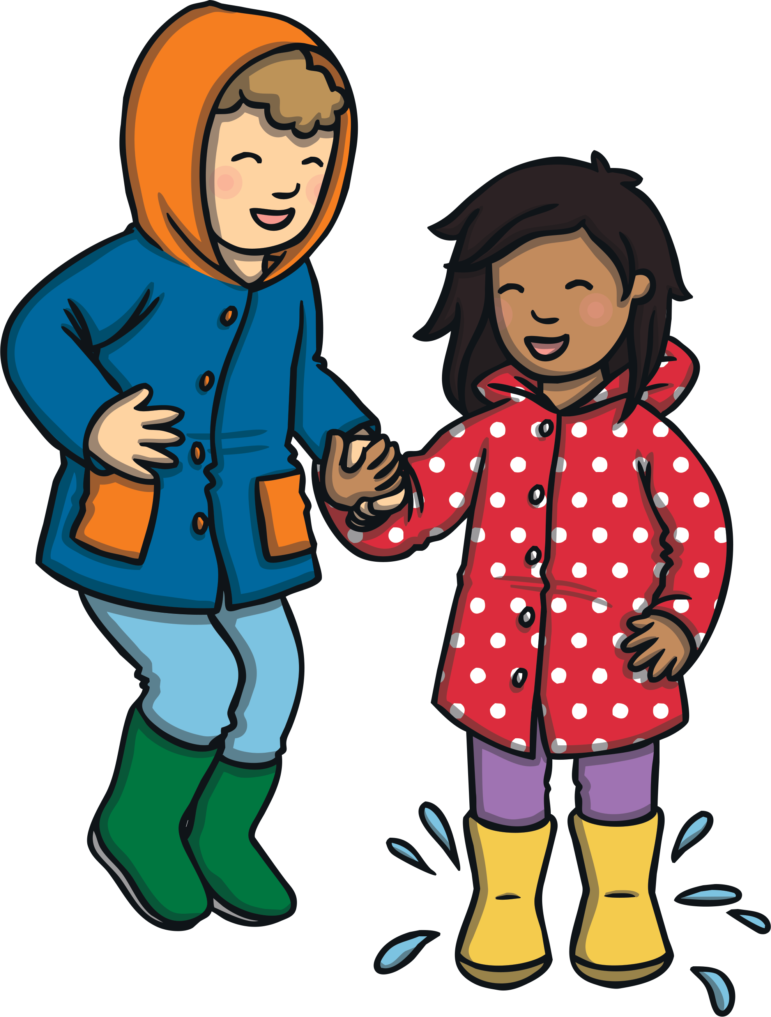

What Is Onomatopoeia?
Onomatopoeia is a word that sounds like the thing or action
it is describing.
Woof!
Splash!

Slide 3
Can you think of any words that sound like the sound a firework would make?
whoosh
bang
Did you think of any others? Create your own list.

Slide 4
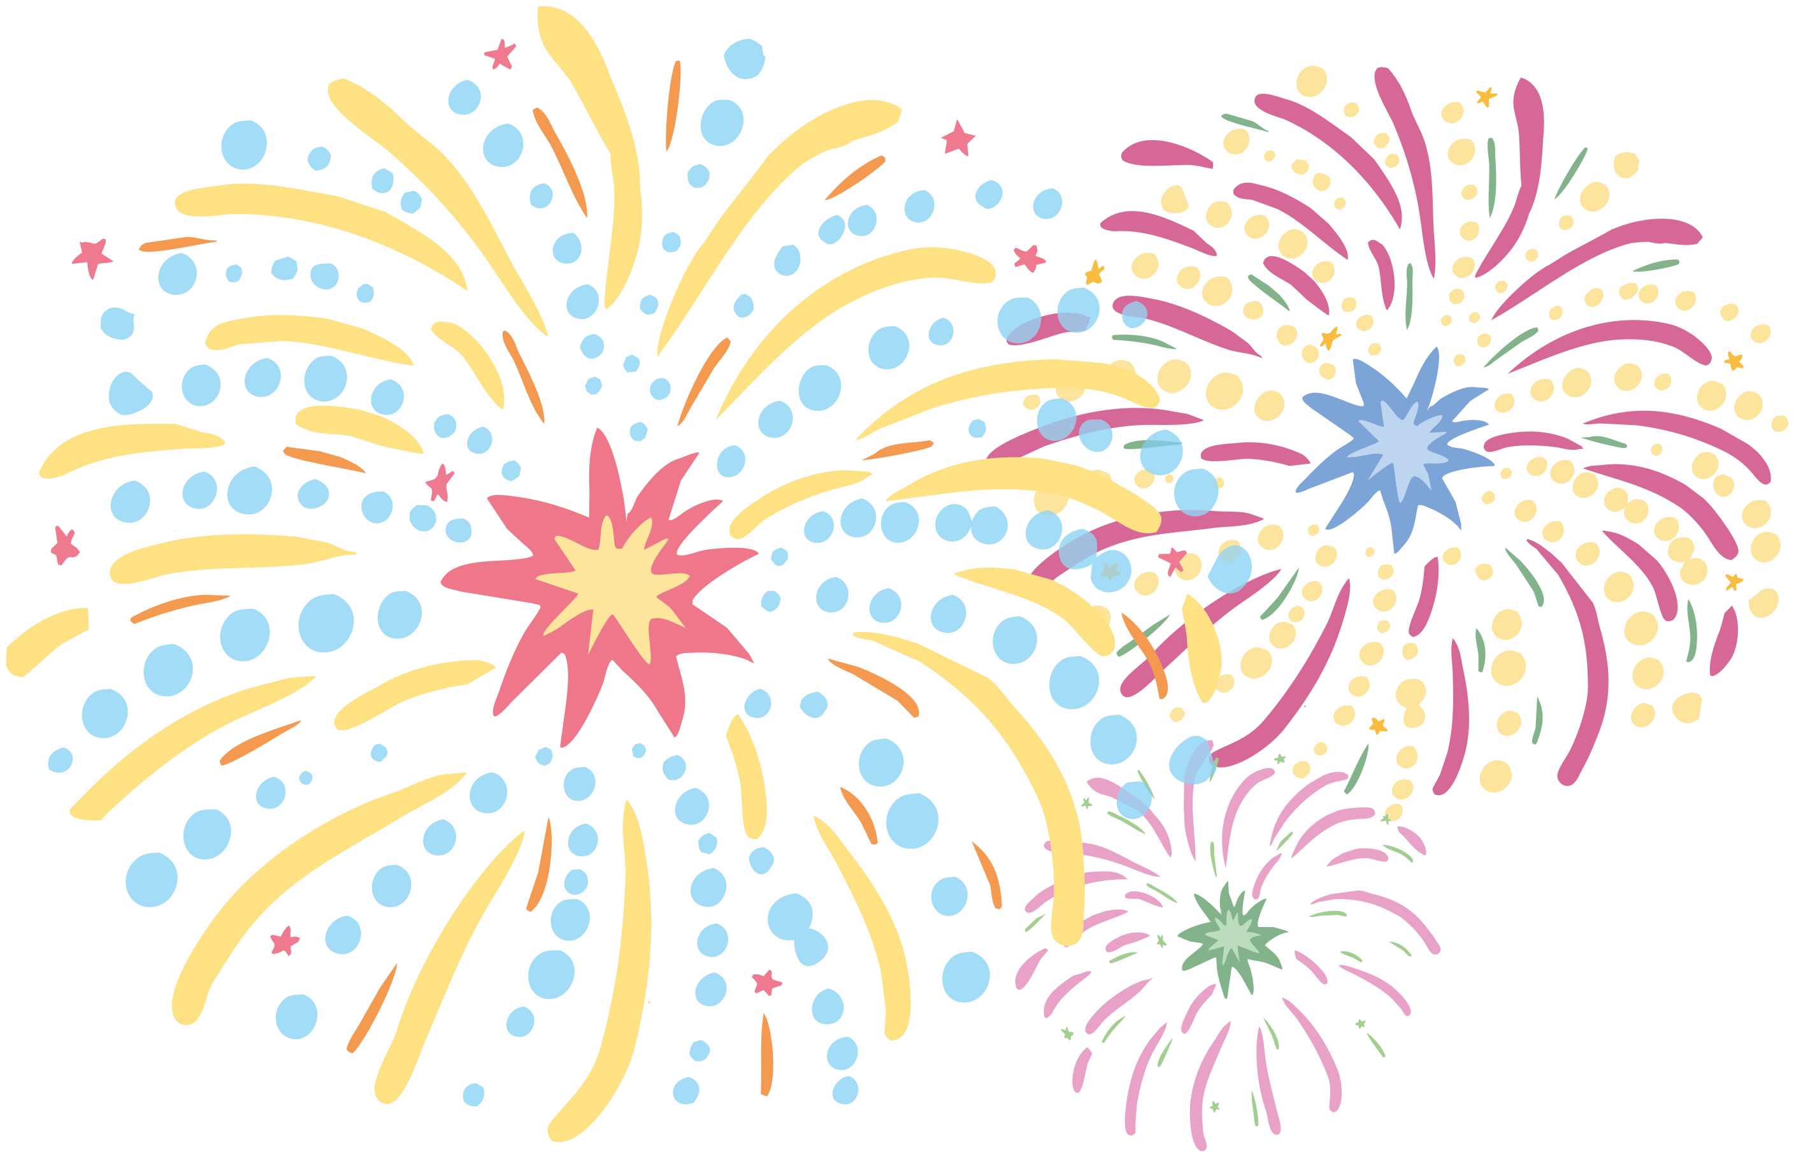
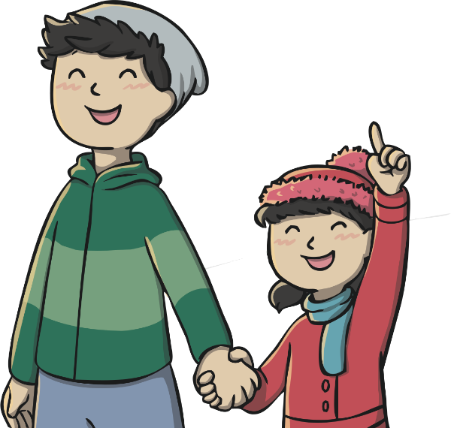
Some Other Ideas
boom
crackle
fizz
crash
pop
zoom

Slide 5
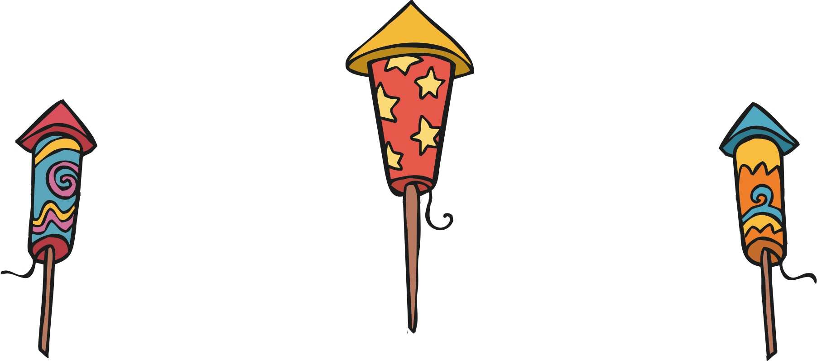
Can you use these words to create your own onomatopoeia firework poem?
Whoosh, zoom, bang! Whoosh, zoom, bang!
I hear the noisy fireworks in the sky.
Crackle, sizzle, spit! Crackle, sizzle, spit!
The glowing bonfire rages fiercely.
Fizz, whizz, buzz! Fizz, whizz, buzz!
Colourful Catherine wheels turn round and round.

Slide 6
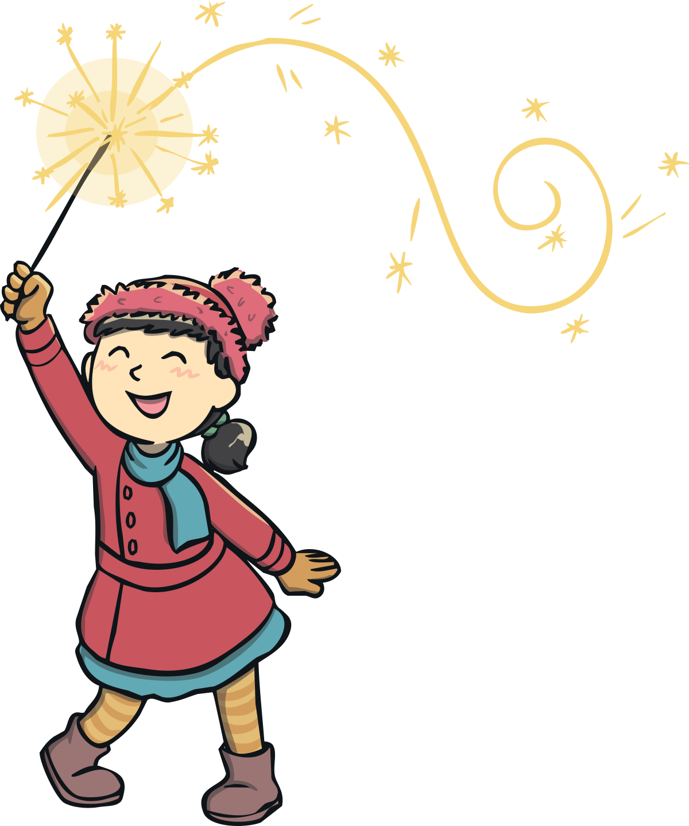
Can you have a go at writing your own onomatopoeia poem?

